Slide 1
Lecture 2:
The nature of cancer (癌症的本质)
Oct 13, 2023
Notes:
总结上一节课内容： 癌症是最大的健康威胁；癌症发生原因包括细胞内因和外界组织环境；细胞内因主要是遗传物质DNA的变异，外因包括免疫系统，能量供应，血管发生等等。

Slide 2
Outline of today`s lecture
1, Tumor arise from normal tissues （肿瘤起源于正常细胞）
2, Tumor classification and typical examples （肿瘤分类及典型代表）
3, Monoclonal growth of tumors（肿瘤本质是单细胞克隆增殖）
4, Cancer metabolism（癌症代谢）
5, Mutagens（诱变剂）and carcinogens（致癌剂）
Notes:
肿瘤起源；肿瘤依据起源的分类；肿瘤发生模式；肿瘤代谢；诱变剂和致癌剂

Slide 3
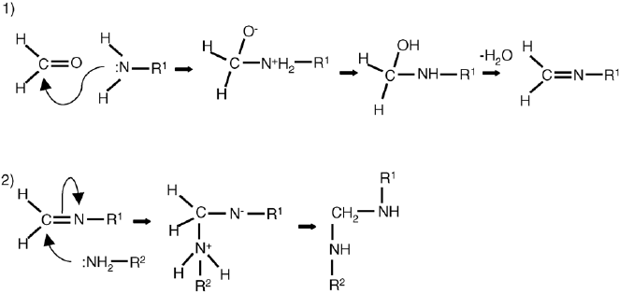
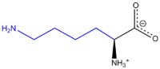
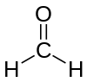
Tissue fixation and section (组织固定与切片)
Tissue fixation （组织固定）目的：保持细胞、组织的固有形态和结构
Crosslinking fixatives - aldehydes
Formaldehyde fixes tissue by cross-linking the proteins, primarily the residues of the basic amino acid lysine.
Formaldehyde
(甲醛)
Lysine (赖氨酸)
Paraffin section（石蜡切片）
Notes:
涉及到不少医学方面的内容，所以讲一下组织固定与切片这个常识；

Slide 4
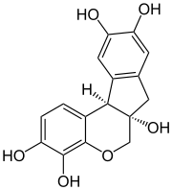
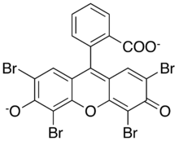
Hematoxylin and eosin stain (H&E stain or HE stain)
(苏木精-伊红染色)
HE stain is one of the principal stains in histology. It is the most widely used stain in medical diagnosis and is often the gold standard; for example when a pathologist looks at a biopsy of a suspected cancer, the histological section is likely to be stained with H&E and termed "H&E section", "H+E section", or "HE section".
这种染色方法的基础是组织结构对不同染料的结合程度不同。染料苏木精（Hematoxylin）可以将嗜碱性结构染成蓝紫色，而伊红（Eosin）可以将嗜酸性结构染成粉红色。嗜碱性结构通常包括含有核酸的部分，如核糖体、细胞核及细胞质中富含核糖核酸（RNA）的区域等。嗜酸性结构则通常由细胞内及细胞间的蛋白质，如路易体（Lewy body）、酒精小体（Mallory body）、细胞质的大部分等。
苏木精（Hematoxylin）
伊红（Eosin）
Notes:
最常见的病理染色

Slide 5
2.1 Tumors arise from normal tissues
Notes:
内在起源的

Slide 6
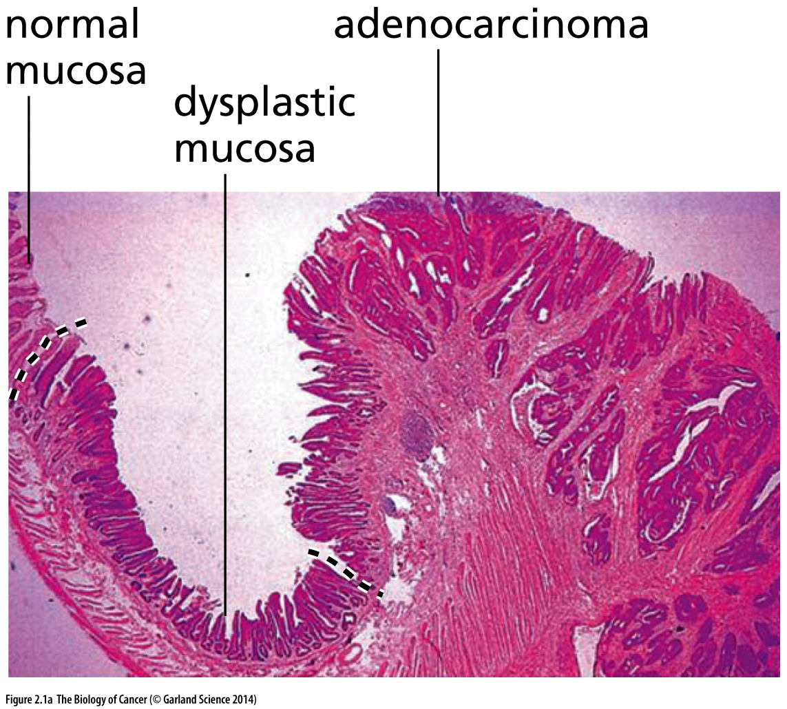
Figure 2.1 Normal versus neoplastic(肿瘤的) tissue
(A) This histological section of the lining of the ileum(回肠) in the small intestine (小肠), viewed at low magnification, reveals the continuity between normal and cancerous tissue. At the far left is the normal epithelial lining the mucosa(黏膜). In the middle is mucosal tissue that has become highly abnormal, or “dysplastic(异型).” To the right is an obvious tumor—an adenocarcinoma(腺癌)—which has begun to invade underlying tissues.
这张图结论：肿瘤细胞和正常细胞同存

Slide 7
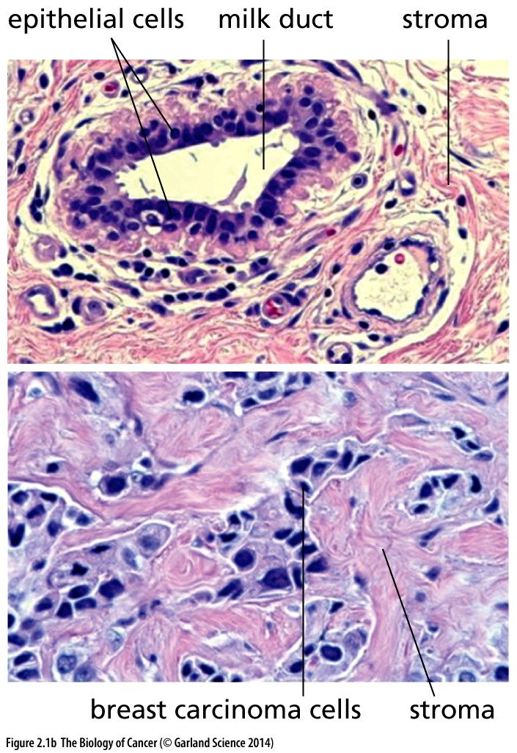
Figure 2.1 Normal versus neoplastic(肿瘤的) tissue
(B) In the normal human mammary gland (upper panel), a milk duct is lined by epithelial cells (dark purple nuclei). These ducts are surrounded by mesenchymal tissue termed “stroma,” which consists of connective tissue cells, such as fibroblasts and adipocytes, and collagen matrix (pink). In an invasive ductal breast carcinoma (lower panel), the cancer cells, which arise from the epithelial cells lining the normal ducts, exhibit abnormally large nuclei (purple), no longer form well-structured ducts, and have invaded the stroma (pink).

Slide 8
Tumors are created by cells that lost the ability to assemble and create tissues of normal form and function.
Primary tumor: 原发瘤;
Metastases: 转移;
Benign (良性) tumor: grew locally without invading adjacent tissues;
Malignant (恶性) tumor: invaded nearby tissues and spawned metastases;

Slide 9
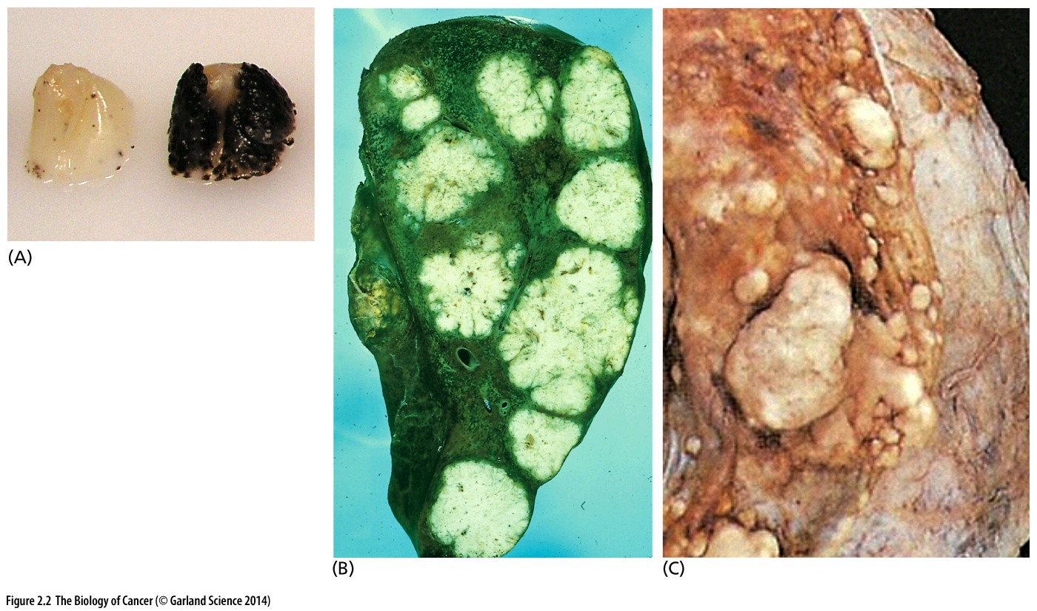
Figure 2.2 Metastasis（转移）of cancer cells to distant sites
(A) Melanoma metastases in mice.
(B) Metastases (white) in the liver often arise in patients with advanced colon carcinomas. The portal vein, which drains blood from the colon into the liver, provides a route for metastasizing colon cancer cells to migrate directly into the liver.
(C) Breast cancer often metastasizes to the brain. Here, large metastases are revealed post mortem in the right side of a brain where the dura (membrane covering; shown intact at right) of the brain has been removed.
Notes:
转移后的肿瘤经常保留起源组织的特征

Slide 10
2.2 Tumors arise from many specialized cell types throughout the body
The majority of human tumors arise from epithelial tissues. Epithelia are sheets of cells that line the walls of cavities and channels or, in the case of skin, serve as the outside covering of the body. By the first decades of the twentieth century, detailed histological analyses had revealed that normal tissues containing epithelia are all structured similarly. Thus, beneath the epithelial cell layers in each of these tissues lies a basement membrane (sometimes called a basal lamina); it separates the epithelial cells from the underlying layer of supporting connective tissue cells, termed the stroma (Figure 2.3).
Notes:
此处重点知识！ 诸如肺癌，乳腺癌，肠癌，肝癌等等都是carcinoma

Slide 11
Cancer classification
Benign
Malignant
Primary tumor
Metastases
Adenocarcinoma (腺癌)
Epithelial origin: Carcinoma
(most cancer belong to this type)
Squamous cell carcinoma (鳞状细胞癌)
Based on the origin of cancer cell
Sarcoma (肉瘤) ~1%
Hematopoietic ~7%
Non-Epithelial origin
Neuroectodermal (神经外胚瘤) ~1-2%
Others, like melanoma, teratoma…
Notes:
重点

Slide 12
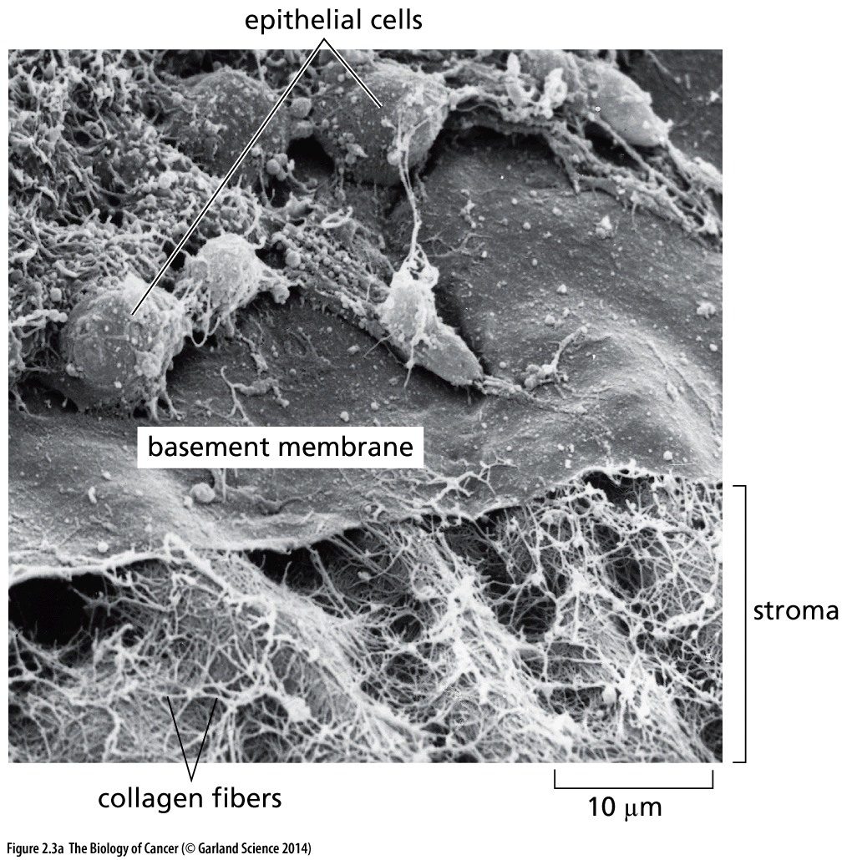
Figure 2.3 Basement membranes(基底膜)
This scanning electron micrograph of a chick corneal(角膜) epithelium.
Basement Membrane separate epithelial cells from stromal cells.

Slide 13
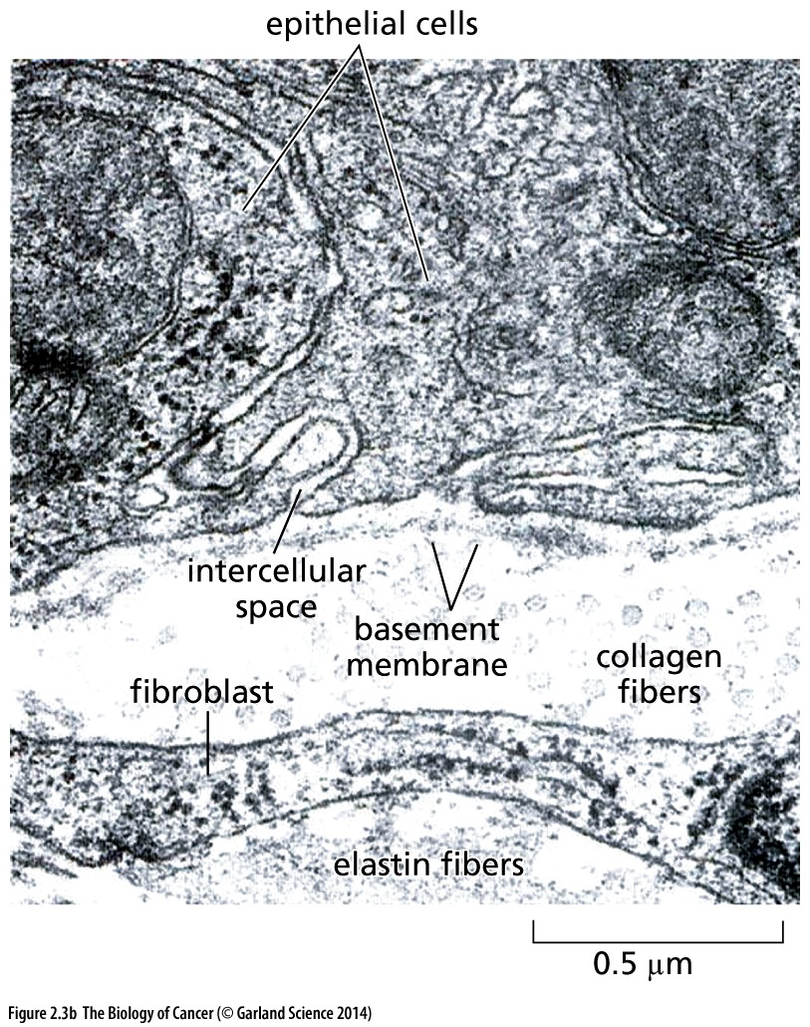
Figure 2.3 Basement membranes
(B) The epithelium of the mouse trachea（气管）is viewed here at far higher magnification through a transmission electron microscope. Several epithelial cells are seen above the basement membrane, while below are collagen fibrils, a fibroblast, and elastin fibers. Note that the basement membrane is not interrupted at the intercellular space between the epithelial cells.
Notes:
此图并不清晰，供参考，结论依然是：基底膜将表皮细胞和基质细胞分开

Slide 14
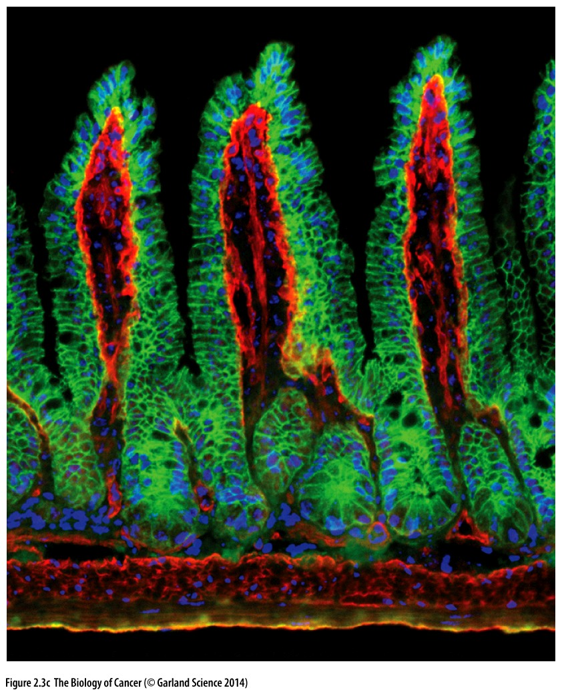
Figure 2.3 Basement membranes
While basement membranes cannot be detected using conventional staining techniques, use of immunofluorescence with an antibody against a basement membrane protein—in this case laminin 5 (red)—allows its visualization. The epithelial cells coating the villi（绒毛）of the mouse small intestine have been stained with an antibody against E-cadherin (green), while all cell nuclei are stained blue. Here the convoluted（卷曲的）basement membrane separates the outer villus layer of epithelial cells, termed enterocytes, from the mesenchymal（间叶细胞）cells forming the core of each villus (not stained).
Notes:
小肠的结构，生理学会讲到。

Slide 15
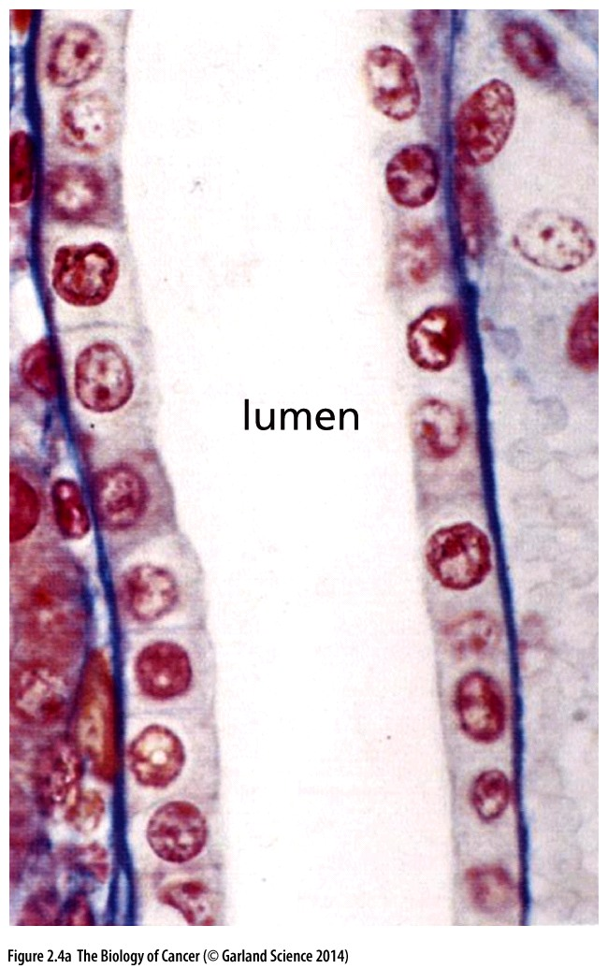
Figure 2.4 Architecture of epithelial tissues
A common organizational plan describes most of the epithelial tissues in the body: The mature, differentiated epithelial cells are at the exposed surface of an epithelium(上皮). In many tissues, underlying these epithelia are less differentiated epithelial cells, not seen in this figure. Beneath the epithelial cell layer lies a basement membrane (基底膜), which is usually difficult to visualize in the light microscope. Shown here are epithelia of (A) a collecting tubule of the kidney(肾),

Slide 16
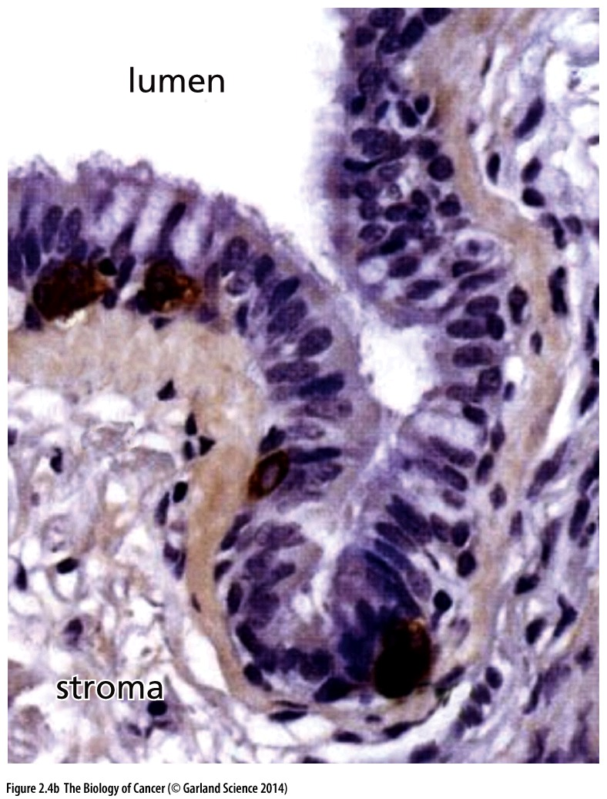
Figure 2.4 Architecture of epithelial tissues
(B) the bronchiole(细支气管) of the lung,

Slide 17
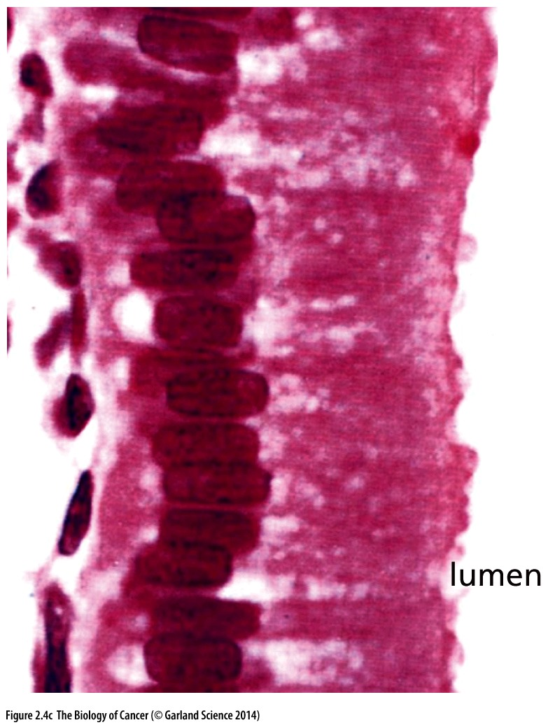
Figure 2.4 Architecture of epithelial tissues
(C) the columnar（柱形的）epithelium of the gallbladder(胆囊)

Slide 18
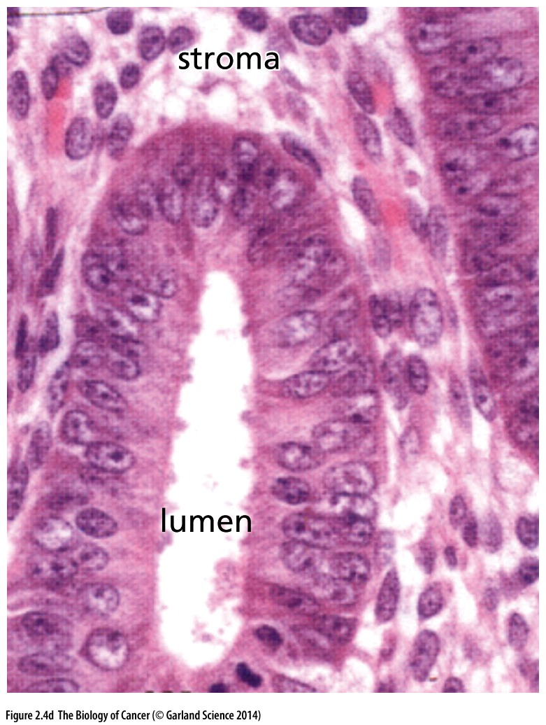
Figure 2.4 Architecture of epithelial tissues
(D) the endometrium（子宫内膜）of the uterus（子宫）
In each case, the epithelial cells protect the underlying tissue from the contents of the lumen (cavity) that they are lining.
Notes:
讲各种类型的上皮细胞组织结构。

Slide 19
The majority（~90% ）of human tumors arise from epithelial (上皮) tissues. These types of cancer are named as carcinoma (上皮肿瘤，也称为癌)
Epithelial of the lungs, liver, gallbladder, pancreases, esophagus, stomach, and intestine all derived from the inner cell layer, the endoderm; Skin arises from the outer embryonic cell layer, termed the ectoderm, while the ovaries originate embryologically from the middle layer, the mesoderm (Figure 2.5). Therefore, in the case of carcinomas, histopathological classification is not informed by the developmental history of the tissue of origin.
Notes:
为什么上皮细胞最容易变成肿瘤细胞？

Slide 20
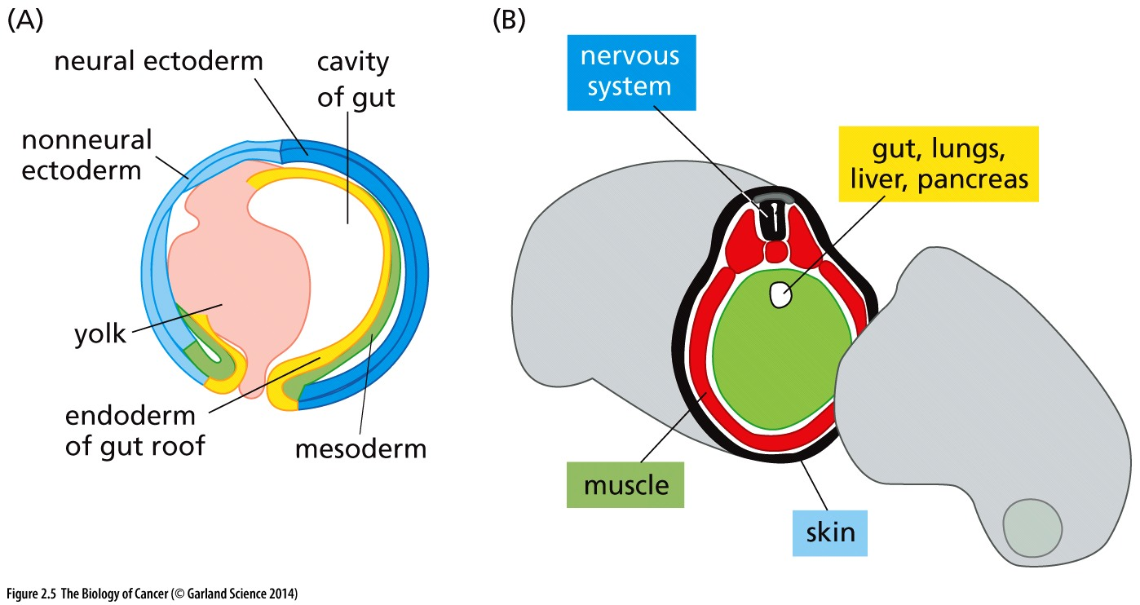
Figure 2.5 Embryonic cell layers
Ectoderm(外胚层): Skin and nervous system;
Mesoderm(中胚层): connective tissues, including bone, muscle, and blood forming cells;
Endoderm(内胚层): gut and derived outpouchings, including lung, pancreases(胰腺), and liver

Slide 21
The majority of human tumors arise from epithelial tissues. These types of cancer are named as carcinoma
Most carcinomas fall into two major categories that reflect the two major biological functions associated with epithelia (Table 2.1). Some epithelial sheets serve largely to seal the cavity or channel that they line and to protect the underlying cell populations (Figure 2.6). Tumors that arise from epithelial cells forming these protective cell layers are termed squamous cell carcinomas（鳞状细胞癌）. For example, the epithelial cells lining the skin (keratinocytes) and most of the oral cavity spawn tumors of this type. Many epithelia also contain specialized cells that secrete substances into the ducts or cavities that they line. This class of epithelial cells generates adenocarcinomas（腺癌）.
Notes:
肿瘤分类，重点

Slide 22
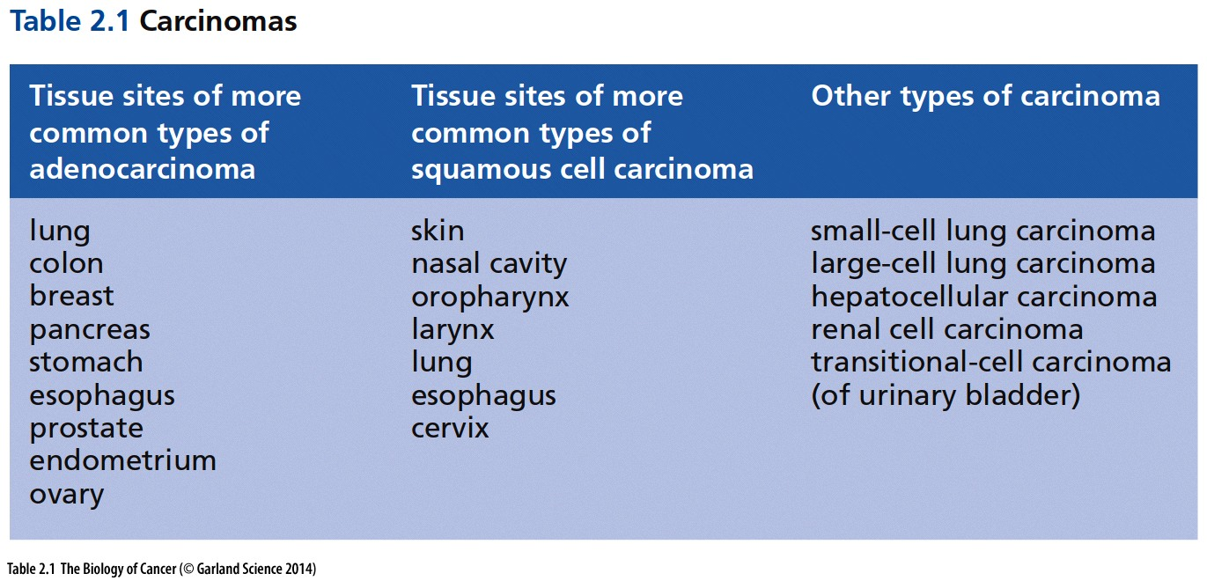
鼻腔
口咽
喉
食管
子宫颈
子宫内膜

Slide 23
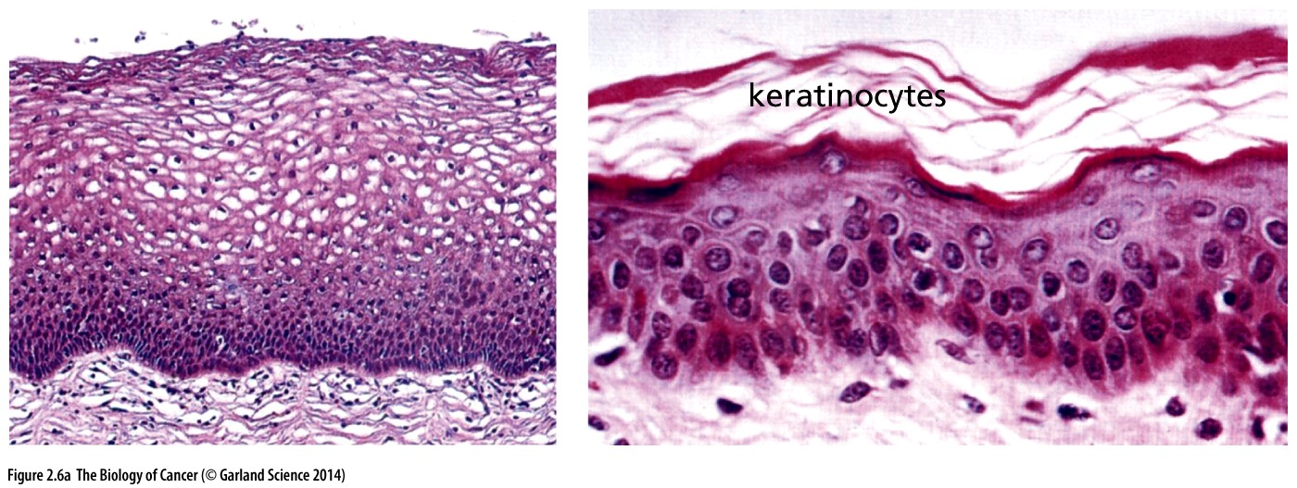
Figure 2.6 Epithelia and derived carcinomas
uterus（子宫）
skin
Normal squamous(鳞状) cells are often flattened and function to protect the epithelium and underlying tissue from the contents of the lumen or, in the case of skin, from the outside world. The squamous epithelia of the cervix of the uterus（子宫）(left) and the skin (right) are organized quite similarly, with mature flattened cells at the surface being continually shed (for example, the dead keratinocytes of the skin) and replaced by less differentiated cells that move upward and proceed to differentiate.

Slide 24
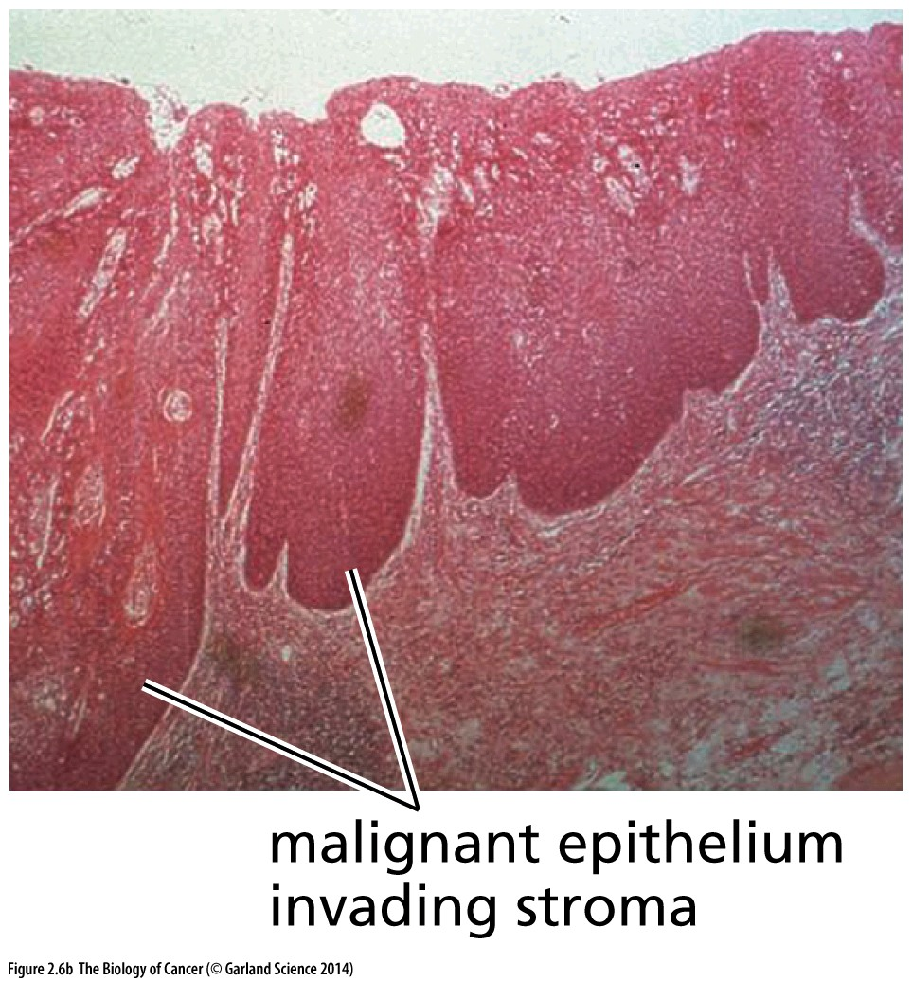
In this carcinoma of the esophagus(食管), large tongues of malignant squamous epithelial cells are invading the underlying stromal/mesenchymal tissue.

Slide 25
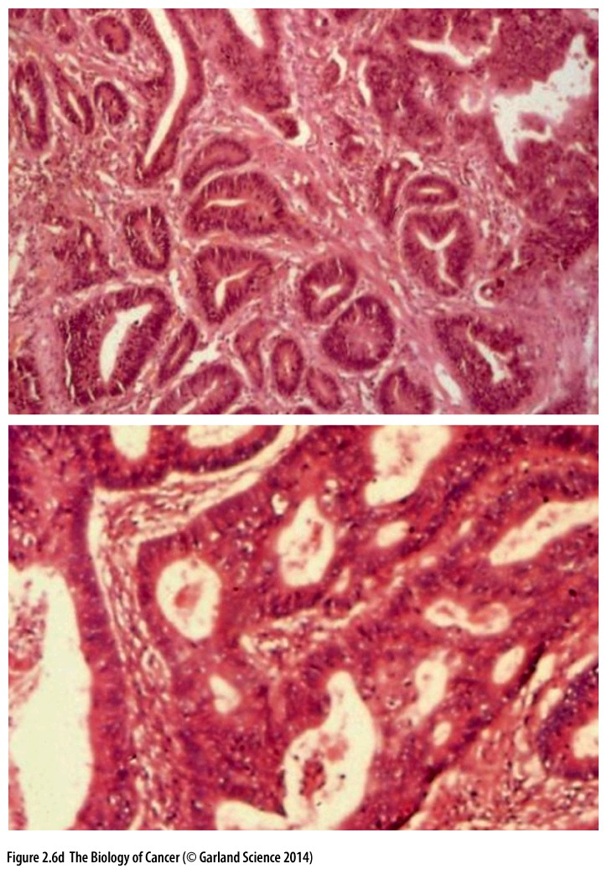
stomach
These adenocarcinomas of the stomach (upper panel) and colon (lower panel) show multiple ductal（导管的）elements, which are clear indications of their derivation from secretory epithelia such as those in panel C.
colon

Slide 26
The remainder of malignant tumors arise from nonepithelial tissues throughout the body. The first major class of nonepithelial cancers derive from the various connective tissues, all of which share a common origin in the mesoderm of the embryo (Table 2.2). These tumors, the sarcomas (肉瘤), constitute only about 1% of the tumors encountered in the oncology clinic. Sarcomas derive from a variety of mesenchymal(间充质细胞) cell types.

Slide 27
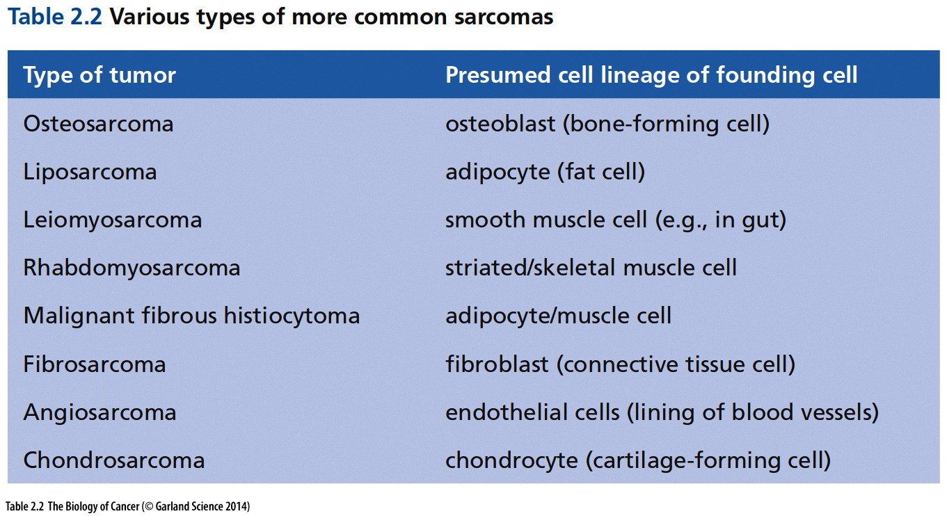
软骨细胞

Slide 28
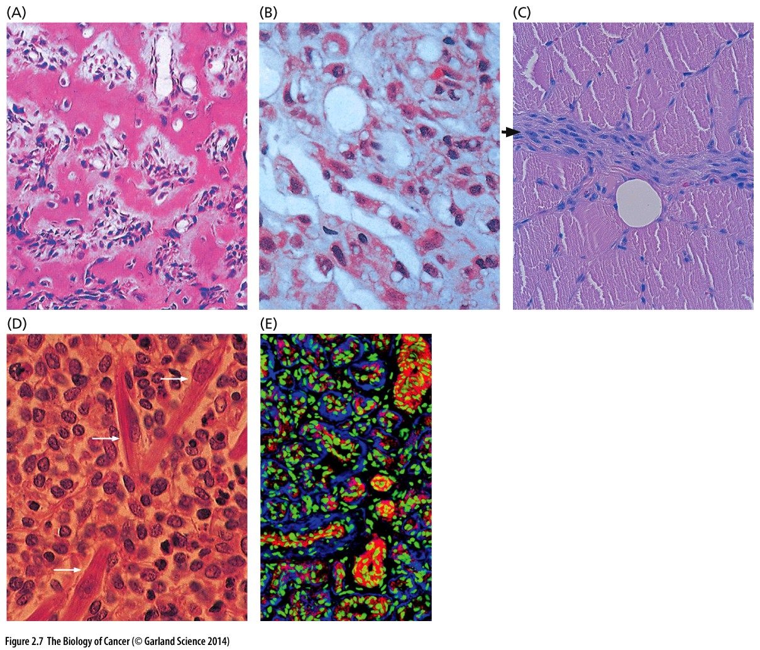
Figure 2.7 Mesenchymal tumors (Sarcoma)
(A) Osteosarcoma (骨肉瘤)
(B) liposarcoma (脂肪肉瘤)
(C) leiomyosarcoma (平滑肌肉瘤)
(D) Rhabdomyosarcoma (横纹肌肉瘤)
(E) Hemangioma (血管瘤)

Slide 29
The second group of nonepithelial cancers arise from the various cell types that constitute the blood-forming (hematopoietic) tissues, including the cells of the immune system (Table 2.3 and Figure 2.8); these cells also derive from the embryonic mesoderm.

Slide 30
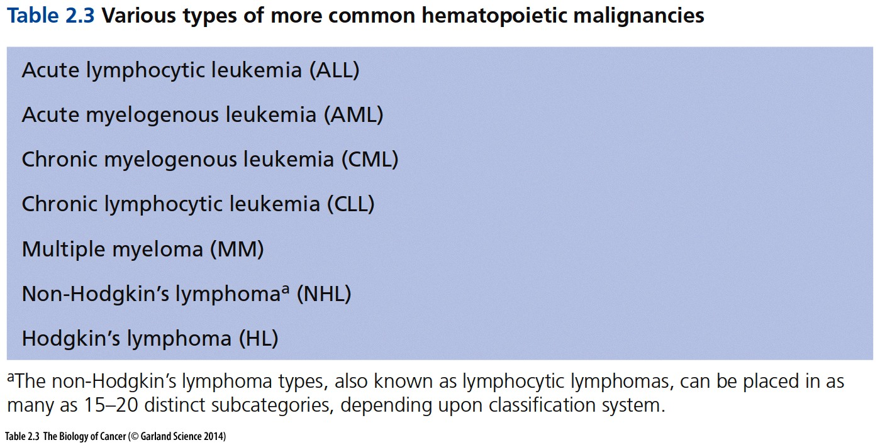
Leukemia：白血病
Lymphoma: 淋巴瘤
Myeloma: 骨髓瘤
Hematopoietic ~7% of total cancer
Notes:
“瘤”意味着类似与实体肿瘤；白血病则无实体肿瘤的表现；白细胞依据形态分为：淋巴细胞、粒细胞、单核细胞。淋巴细胞是一类具有免疫识别功能的细胞系，按其发生迁移、表面分子和功能的不同，可分为T淋巴细胞（又名T细胞）、B淋巴细胞（又名B细胞）和自然杀伤(NK)细胞。粒细胞是胞质中有特殊颗粒的白细胞，用瑞氏染料染色可分辨出三种颗粒白细胞即中性粒细胞、嗜酸性粒细胞和嗜碱性粒细胞；无颗粒白细胞包括单核细胞和淋巴细胞。绝大部分的粒细胞是中性粒细胞，为参与先天免疫的吞噬细胞。单核细胞为体积最大的的白细胞，为巨噬细胞，树突状细胞的前身。

Slide 31
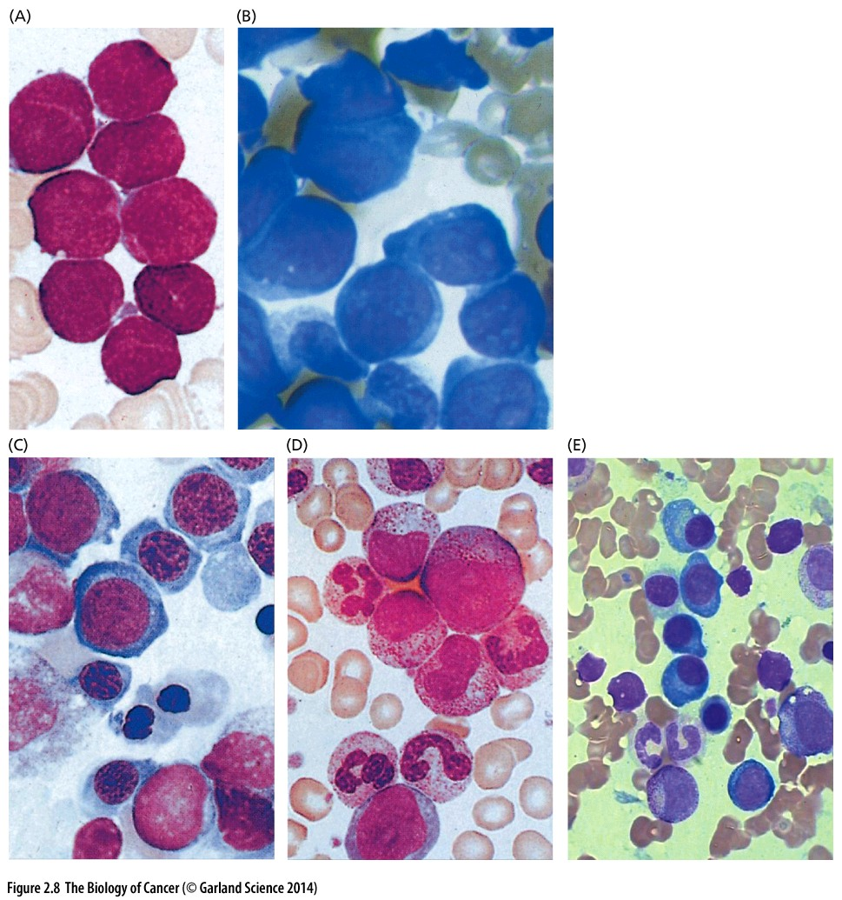
Figure 2.8 Hematopoietic malignancies
Wright-Giemsa stain
Wright and Giemsa stains are used to stain peripheral blood and bone marrow smears. The most important components of these stains are oxidized methylene blue, azure B and eosin Y dyes. The eosin Y dye stains the cytoplasm of cells an orange to pink color. The methylene blue and azure B dyes stain the nucleus varying shades of blue to purple.

Slide 32
The third and last major grouping of nonepithelial tumors arises from cells that form various components of the central and peripheral nervous systems (Table 2.4). These are often termed neuroectodermal tumors (神经外胚瘤) to reflect their origins in the outer cell layer of the early embryo. Included here are gliomas, glioblastomas, neuroblastomas, schwannomas, and medulloblastomas (髓母细胞瘤) (Figure 2.9). While comprising only 1.3% of all diagnosed cancers, these are responsible for about 2.5% of cancer-related deaths.
Notes:
Medulloblastomas is the most common type of pediatric malignant primary brain tumor (cancer)

Slide 33
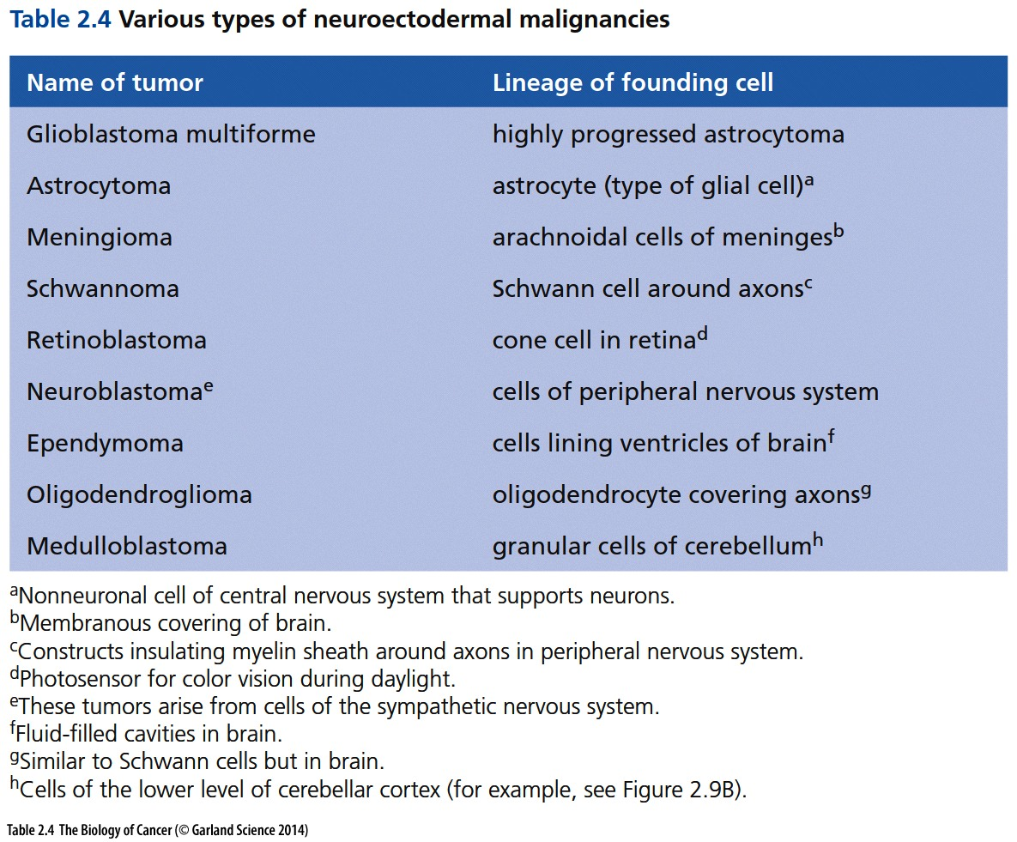
髓母细胞瘤

Slide 34
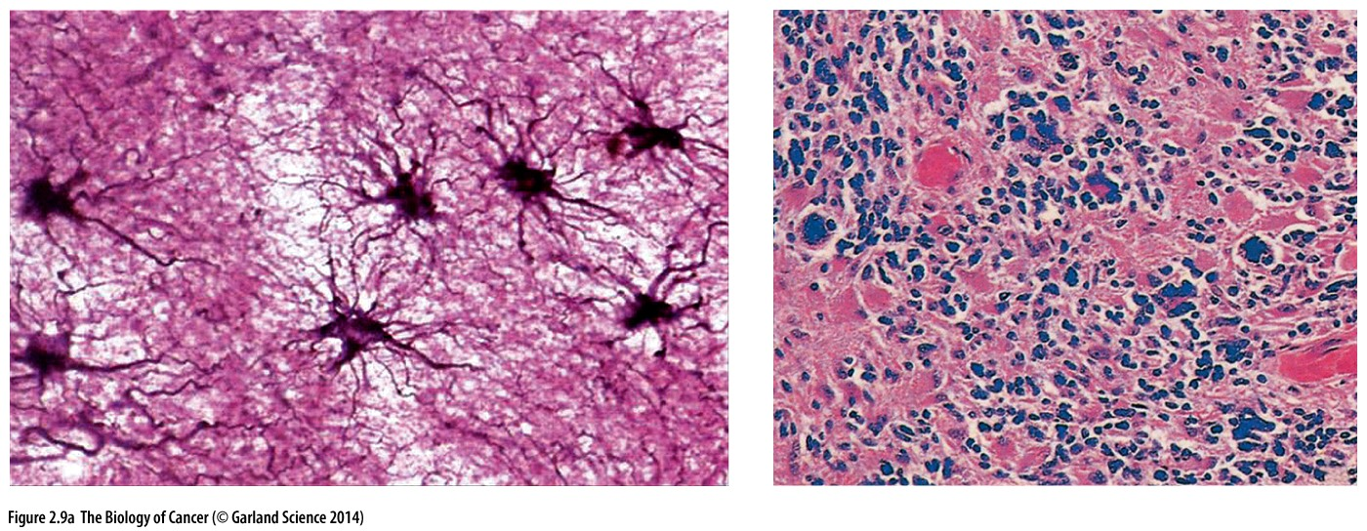
Figure 2.9 Neuroectodermal tumors
(A) Astrocytes(星型胶质细胞)—nonneuronal, supporting cells of the brain (dark purple, left panel)—are the presumed precursors of astrocytomas and glioblastomas (right panel).

Slide 35
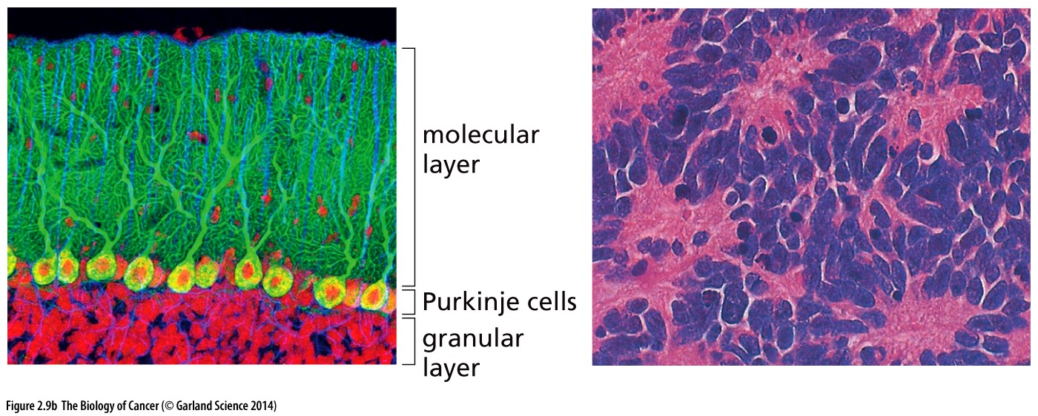
(B) Cells of the granular(颗粒状的) layer of the cerebellum(小脑)(left panel) reside below Purkinje cells and cells of the molecular layer in the cortex of the cerebellum. The precursors of granular cells yield medulloblastomas(髓母细胞瘤)(right panel), the cells of which are notable for their ability to differentiate into neurons, glial cells, and pigmented neuroepithelial cells (purple nuclei, pink cytoplasms).

Slide 36
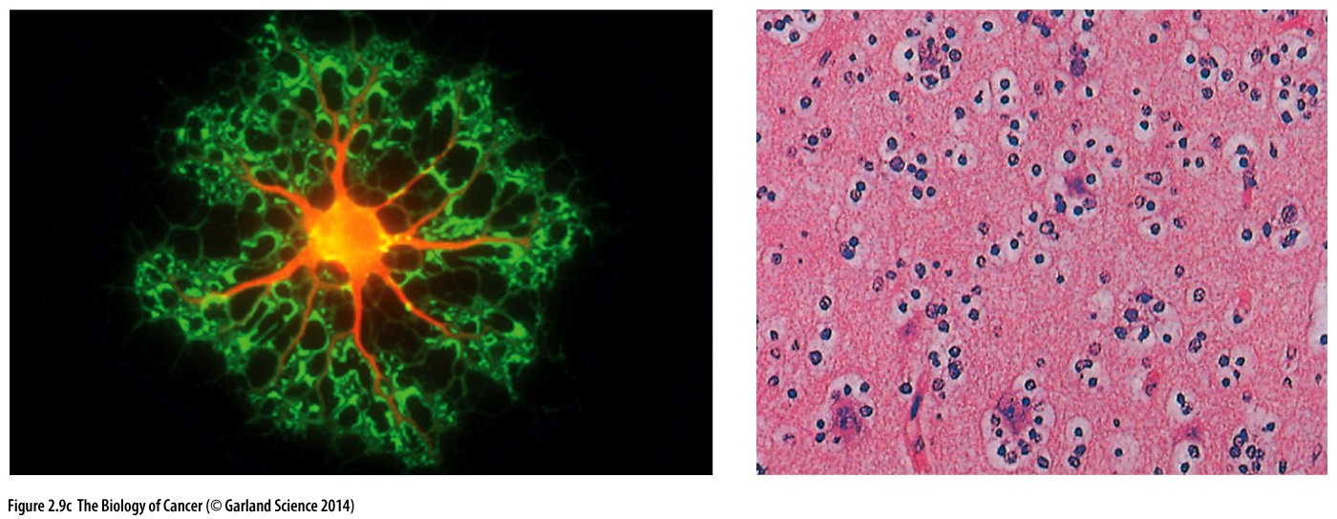
(C) Shown is an oligodendroglioma(少突神经胶质瘤)(right), which derives from oligodendrocytes, nonneuronal cells of ectodermal origin that support and insulate axons in the central nervous system.
Notes:
Each of the neoplastic cell nuclei here has a halo around it, which is characteristic of this tumor. The cultured normal oligodendrocyte shown here (left) exhibits a number of branching (dendritic) arms—each of which associates with one or several axons and proceeds to form an insulating myelin sheath around a segment of each of these axons. The cell body has been immunostained (yellow/orange) for the O4 oligodendrocyte marker, while the tips of the dendritic arms (green) have been stained for CNPase, an enzyme associated with myelination of axons.

Slide 37
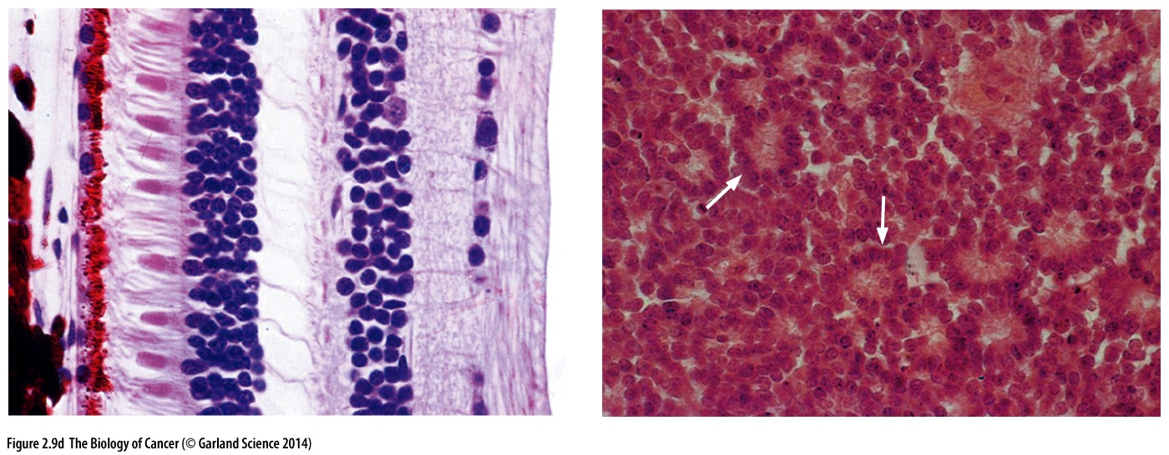
(D) Rods, cones, and other neuronal cell types (left panel) constitute important components of the normal retina. Retinoblastomas(视网膜母细胞瘤)(right panel) arise from cells with attributes of the cone (圆锥体) precursors present in the normal developing retina. Retinoblastomas often show the characteristic rosettes(玫瑰花结), indicated here with arrows.

Slide 38
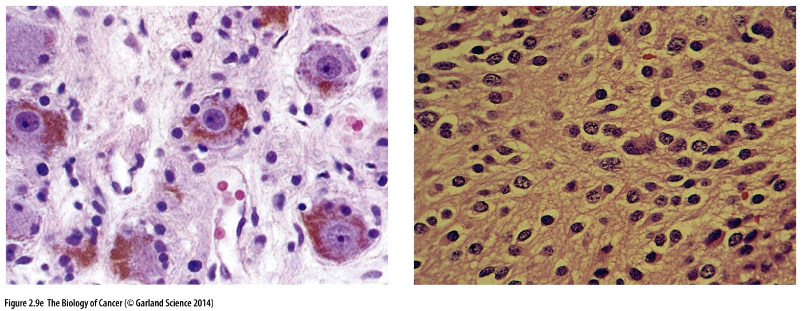
(E) Cells of the sympathetic ganglia(交感神经节)of the peripheral nervous system (larger cells, left panel) give rise to neuroblastomas (right panel), which are usually seen in children. The individual tumor cells here are surrounded by dense fibrillary webs, which are derived from neurites—cytoplasmic processes used by neurons to communicate with one another.

Slide 39
2.3 Some types of tumors do not fit into the major classifications
Not all tumors fall neatly into one of these four major groups. For example, melanomas (黑色素瘤) derive from melanocytes, the pigmented cells of the skin and the retina. The melanocytes, in turn, arise from a primitive embryonic structure termed the neural crest. While having an embryonic origin close to that of the neuroectodermal cells,
The melanocytes end up during development as wanderers that settle in the skin and the eye, provide pigment to these tissues, but acquire no direct connections with the nervous system (Figure 2.10).

Slide 40
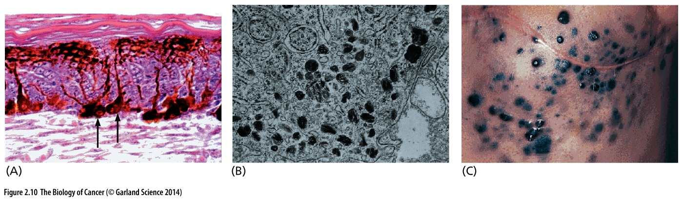
Figure 2.10 Melanocytes and melanomas(黑色素瘤)
(A) Melanocytes (arrows), which form melanin pigment granules, are normally scattered among the basal keratinocytes of the skin. They extend long, thin cytoplasmic processes through which they deposit these granules in the cytoplasm of keratinocytes, which form the bulk of the epithelium.
(B) The pigment granules, visualized here by transmission electron microscopy, have made melanomas favored objects of research because the metastases that they form are easily visualized.
(C) This case of cutaneous melanoma dramatizes the metastatic nature of the disease and the readily observed, pigmented metastases.
Notes:
黑色素细胞功能? 人肤色的决定因素，黑人白人区别即在此，细胞数量差不多，差异在于细胞中色素含量。 黑人/白人的黑色素瘤发病率有显著差别，黑人明显少。

Slide 41
Of the atypical tumor types, teratomas (畸胎瘤) are arguably the most bizarre of all, in part because they defy all attempts at classification. While only ~10,000 cases are diagnosed worldwide annually, teratomas deserve mention because they are unique and shed light on the biology of embryonic stem (ES) cells

Slide 42
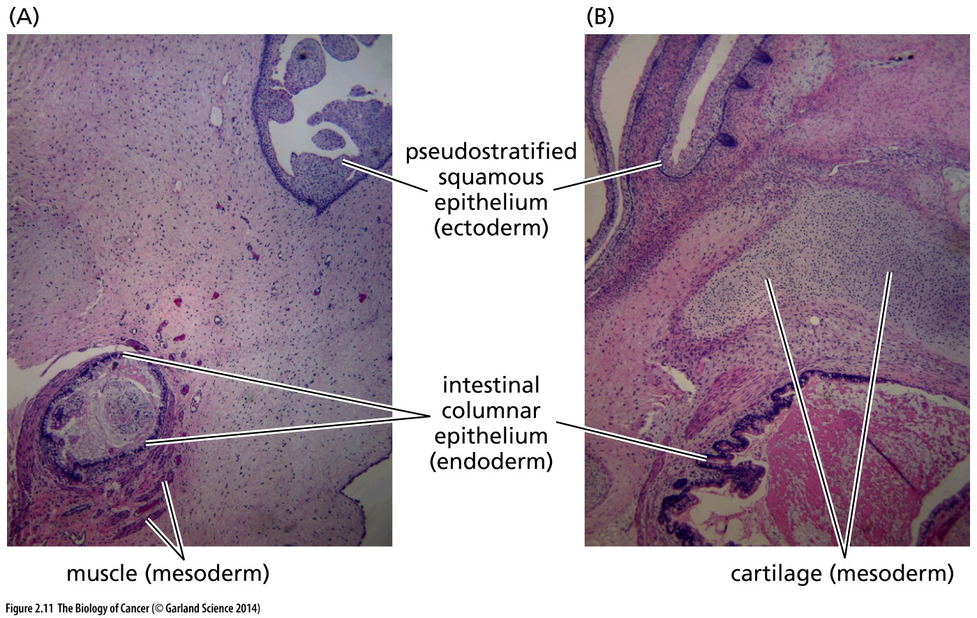
Figure 2.11 Teratomas(畸胎瘤)
This teratoma was created by implanting human embryonic stem (ES) cells into a mouse, yielding a tumor that is a phenocopy of the spontaneous teratomas found in children; such “mature” teratomas contain fully differentiated cells and are localized, noninvasive tumors. The two sections of this teratoma (A, B) indicate the typical behavior of these tumors, in that different sectors of this tumor have formed differentiated tissues deriving from all three cell layers of the early embryo depicted in Figure 2.5.

Slide 43
Cancer cells deviate substantially in behavior from their normal cellular precursors, they almost always retain some of the distinctive attributes of the normal cell types from which they have arisen.

Slide 44
2.4 Cancers seem to develop progressively
具体中间过程包括如下步骤：
Hyperplastic (增生)
Dysplastic (异型)
Pre-invasive polyps (息肉)
Invasive carcinomas
Metaplastic (化生的)
Appears normal
Notes:
化生(metaplasia) 是指一种分化成熟的组织被另一种分化成熟的组织取代的过程

Slide 45
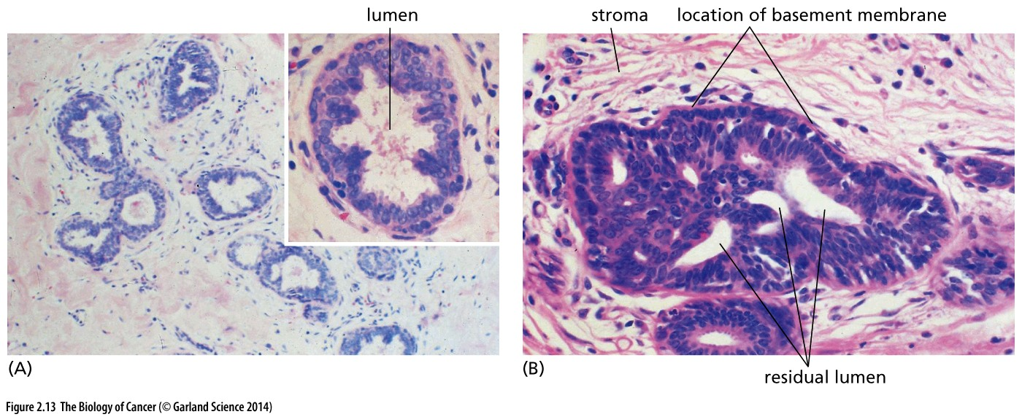
Figure 2.13 Normal versus hyperplastic(增生) epithelium
The morphology of the normal ductal epithelium of the mammary gland can be compared with different degrees of hyperplasia. (A) In these mildly hyperplastic milk ducts, shown at low magnification and high magnification (inset), mammary epithelial cells have begun to form piles that protrude into the lumina. (B) A more advanced hyperplastic mammary duct shows epithelial cells that are crowded together and almost completely fill the lumen. However, they have not penetrated the basement membrane (not visible) and invaded the surrounding stroma.
Notes:
供了解参考

Slide 46
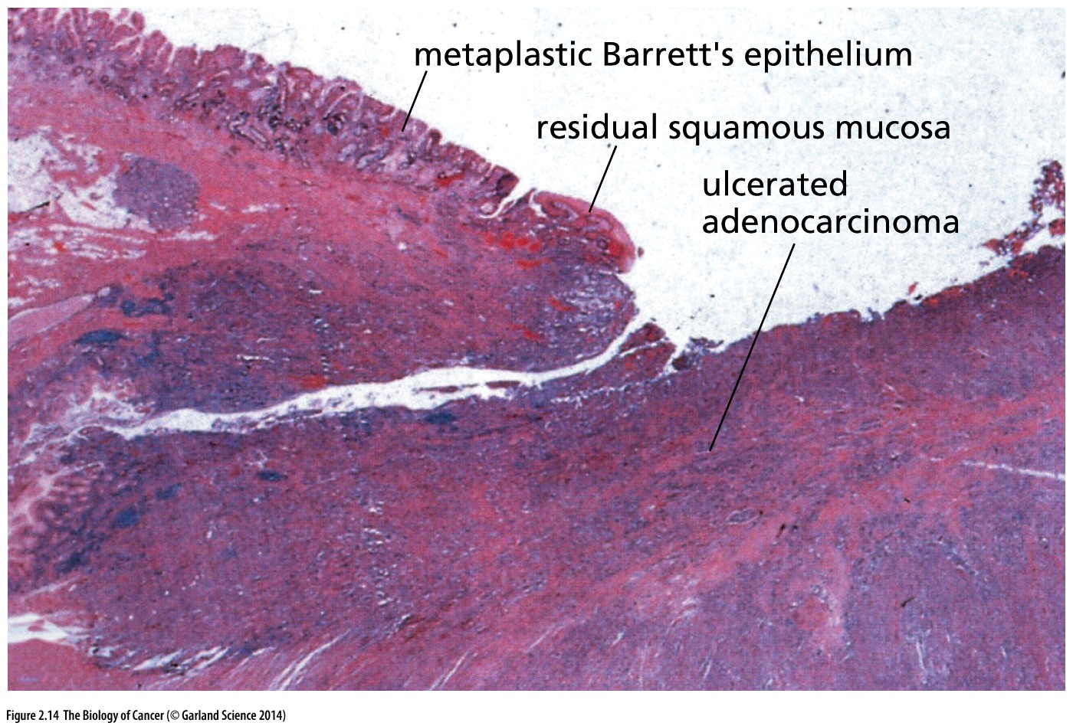
Figure 2.14 Metaplastic (化生的) conversion of epithelia
In certain precancerous conditions, the normally present epithelium is replaced by an epithelium from a nearby tissue—the process of metaplasia. For example, in Barrett’s esophagus(食管), the squamous cells that normally line the wall of the esophagus (residual squamous mucosa) are replaced by secretory cells that migrate from the lining of the stomach(胃) (metaplastic Barrett’s epithelium).
Notes:
化生(metaplasia) 是指一种分化成熟的组织被另一种分化成熟的组织取代的过程，化生常发生在不同类型上皮细胞交界处。

Slide 47
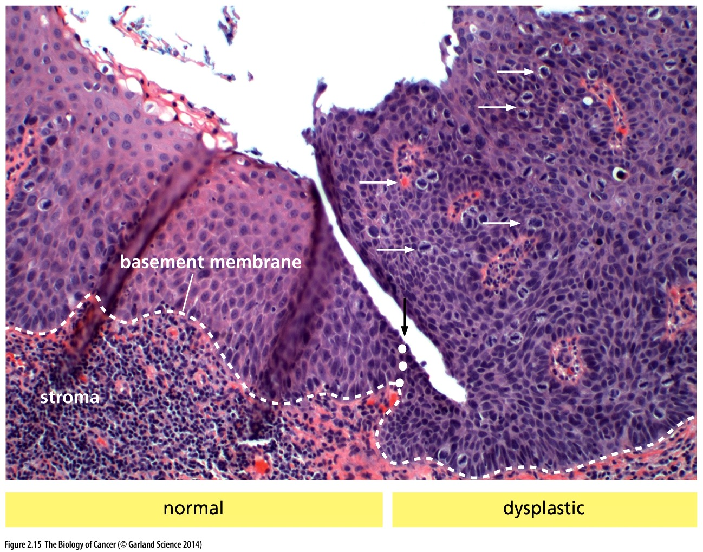
Figure 2.15 Formation of dysplastic (异型) epithelium
In this intraepithelial squamous neoplasia of the cervix(子宫颈) (to right of white dotted line, black arrow), the epithelial cells have not broken through the basement membrane (not visible, indicated by white dashed line) and invaded the underlying stroma. The cells in this dysplasia continue to be densely packed all the way to the luminal surface (above), in contrast to the more diffuse distribution of cells in the normal epithelium (left), whose cytoplasms (light pink) increase in size as the cells differentiate. Numerous mitotic figures are also apparent in the dysplasia (white arrows), indicating extensive cell proliferation.

Slide 48
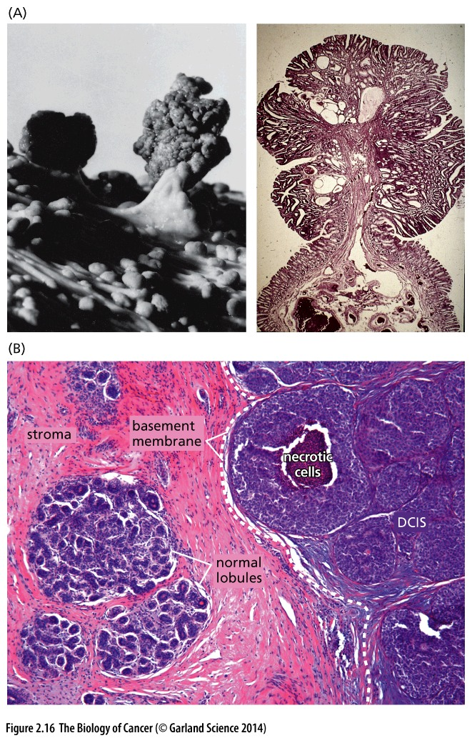
Figure 2.16 Pre-invasive adenomas and carcinomas
Adenomatous(腺瘤的) growths, termed polyps(息肉) in certain organs, have a morphology that sets them clearly apart from normal and dysplastic epithelium.

Slide 49
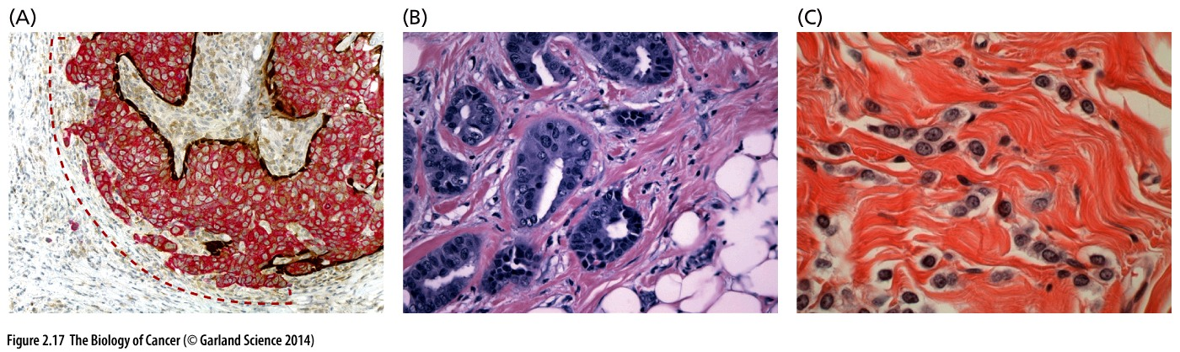
Figure 2.17 Invasive carcinomas
Tumors are considered malignant only after they have breached the basement membrane and invaded the surrounding stroma.

Slide 50
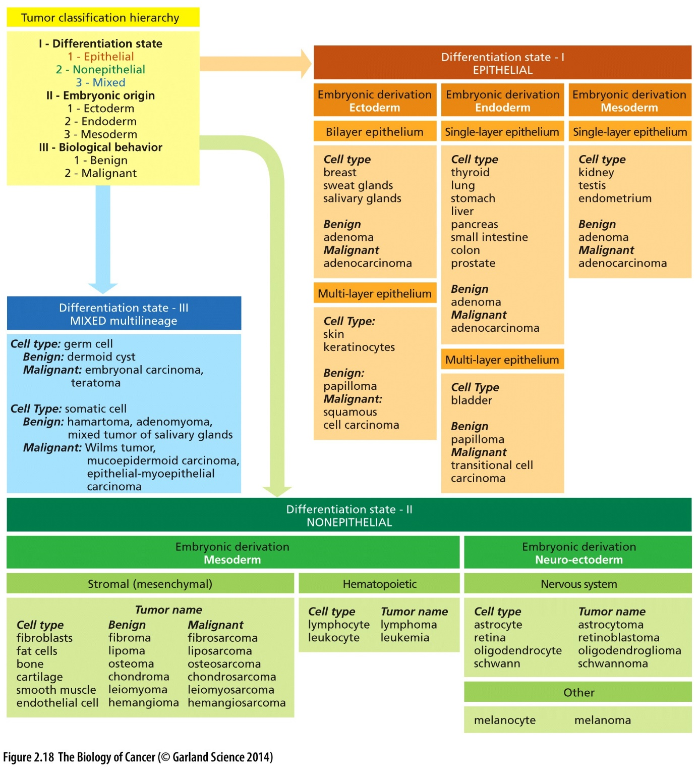
Figure 2.18 Classification scheme of tumors
A clear understanding of the histopathological classification of tumors is essential for the study of cancer. However, the entire spectrum of tumors arising in various organs and tissues has been difficult to capture in a single classification scheme that is either purely morphologic or purely molecular. This has necessitated the use of histological features of tumor cells together with information about their respective tissues-of-origin, differentiation states, and biological behaviors; together these make it possible to develop a taxonomy of human tumors that has proven useful for the diagnosis and clinical management of most tumors.

Slide 51
Do the tumor cells descend from a single ancestral cell that crossed over the boundary from normal to abnormal growth? Or did a large cohort of normal cells undergo this change, each becoming the ancestor of a distinct subpopulation of cells within a tumor mass?
2.5 Tumors are monoclonal growths

Slide 52
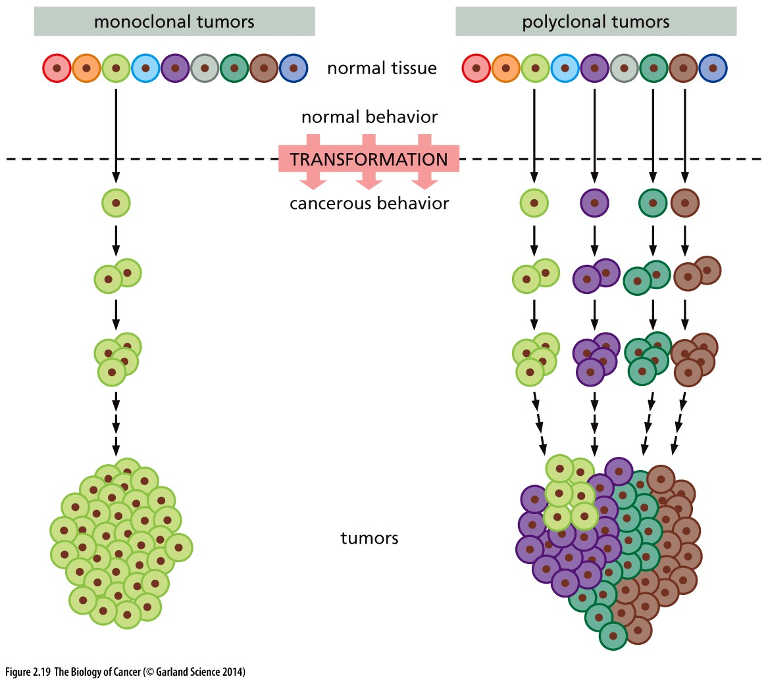
Figure 2.19 Monoclonality versus polyclonality of tumors
In theory, tumors may be polyclonal or monoclonal in origin. In a polyclonal tumor (right), multiple cells cross over the border from normalcy to malignancy to become the ancestors of several, genetically distinct subpopulations of cells within a tumor mass. In a monoclonal tumor (left), only a single cell is transformed from normal to cancerous behavior to become the ancestor of the cells in a tumor mass.

Slide 53
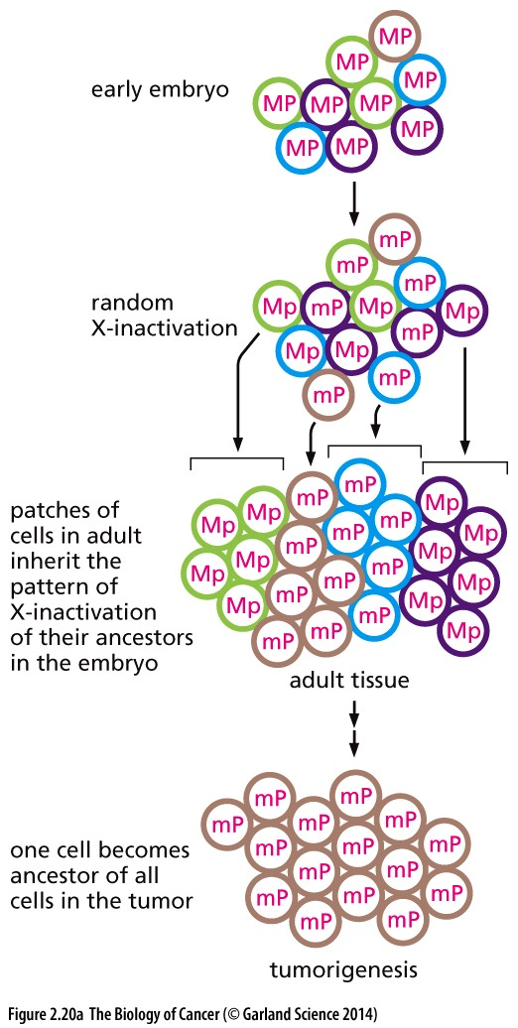
Figure 2.20 X-chromosome inactivation patterns and the monoclonality of tumors
(A) While the female embryo begins with both X chromosomes in an equally active state, either the X chromosome inherited from the mother (M) or the one from the father (P) soon undergoes inactivation at random. Such inactivation silences expression of almost all genes on that chromosome. In the adult, all of the lineal descendants of a particular embryonic cell continue to inactivate the same X chromosome. Hence, the adult female body is made of patches (clones) of cells of the type Mp and patches of the type mP, where the lowercase letter denotes an inactivated state.

Slide 54
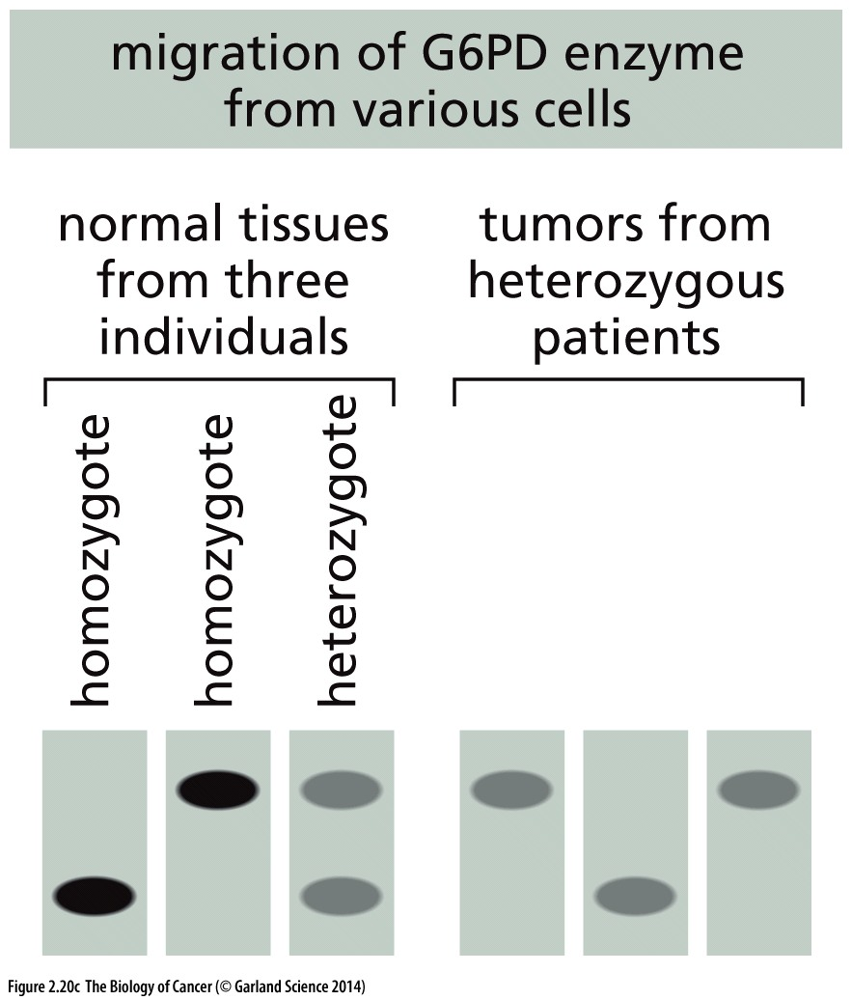
(C) Use of starch（淀粉）gel electrophoresis to resolve the two forms of G6PD showed that all of the cancer cells in a tumor from a G6PD heterozygous patient express the same version of this enzyme. This indicated their likely descent from a common ancestral cell that already had this particular pattern of X-inactivation, suggesting that the cancer cells within a tumor mass constitute a monoclonal growth.

Slide 55
Monoclonality versus heterogeneity
肿瘤单克隆起源（monoclonal origin）
肿瘤异质性（Tumor heterogeneity）

Slide 56
2.6 Cancer cells exhibit an altered energy metabolism(能量代谢)
First reported in 1924 by Otto Warburg
Aerobic glycolysis(有氧糖酵解), sometimes called the Warburg effect
Notes:
提到肿瘤细胞的特征，细胞代谢，上世纪二十年代发现

Slide 57
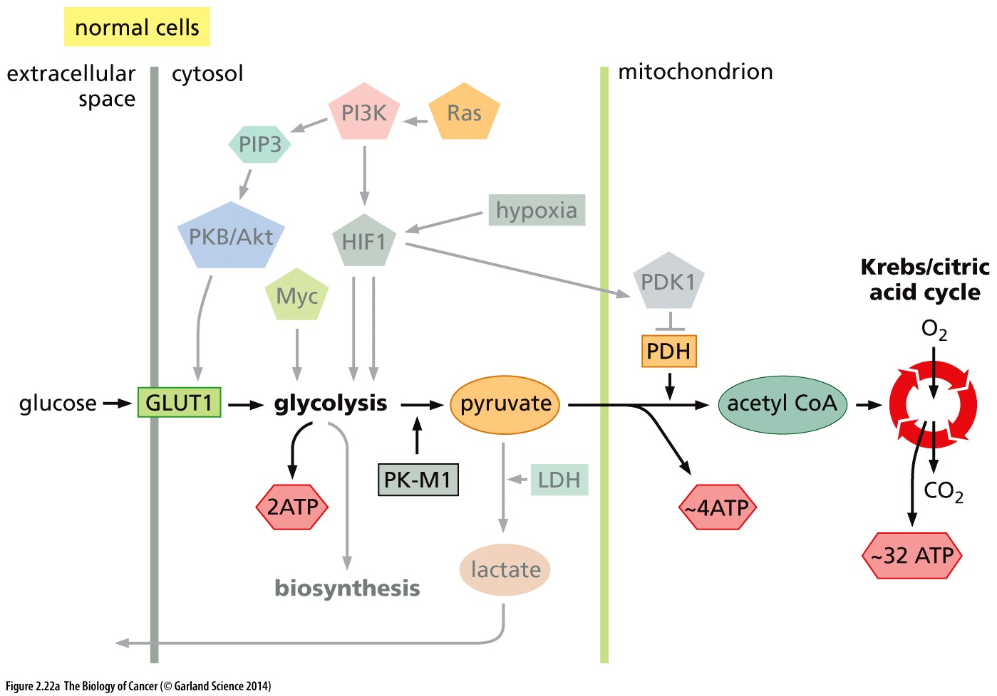
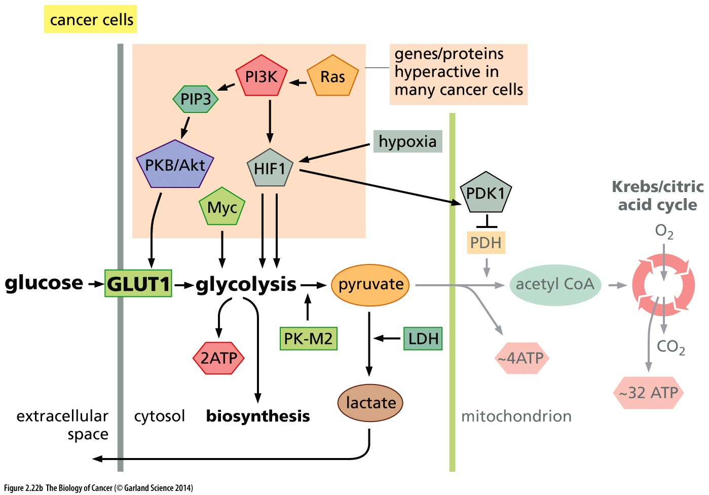
Figure 2.22 Changes in glucose metabolism in cancer cells

Slide 58
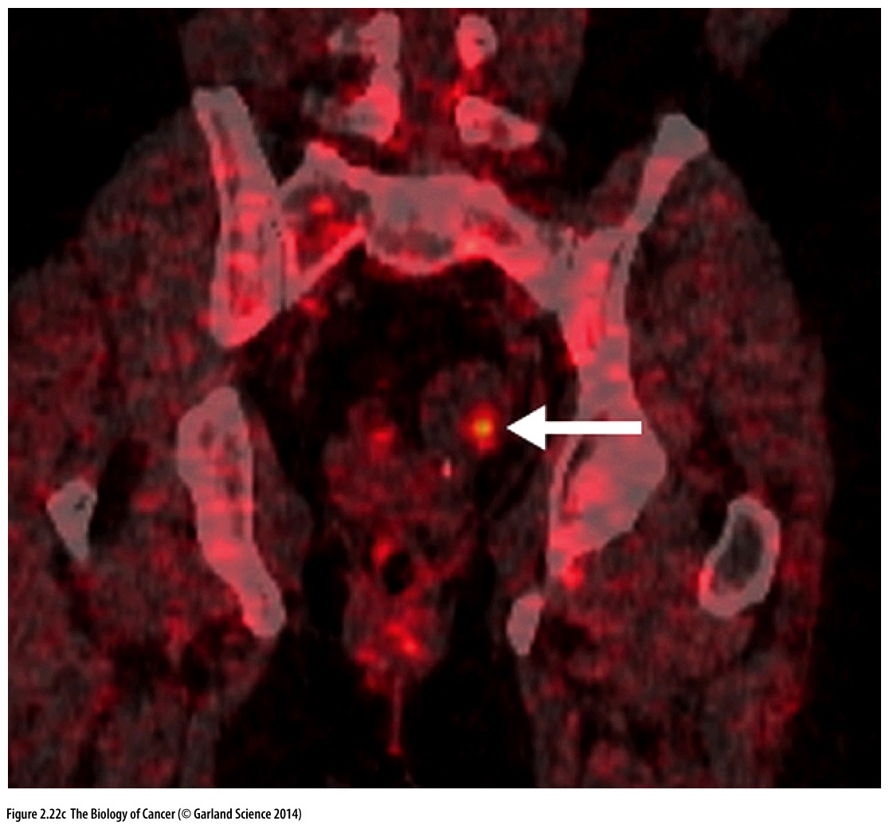
Figure 2.22 Changes in glucose metabolism in cancer cells
2-Deoxy-2-(¹⁸F)fluoro-D-glucose positron(正电子)-emission tomography (FGD-PET) makes it possible to visualize tumors in the body that have concentrated large amounts of glucose because of the hyperactivity of the GLUT1 transporter in the associated cancer cells. In the case shown here, FDG-PET revealed a small tumor (bright orange; arrow) in the region near an ovary of a woman who was under treatment for breast cancer but was otherwise without symptoms. X-ray-computed tomography (CT) was used at the same time to image the outlines of the tissues of this patient. This highly sensitive technology provided the first indication of an incipient (开始的) ovarian cancer in this patient.
FGD-PET is a widely used application based on cancer metabolism

Slide 59
2.7 Cancers occur with vastly different frequencies in different human populations
Notes:
前列腺癌美国多，中国少，肝癌反之；原因是遗传背景OR生活习惯？

Slide 60
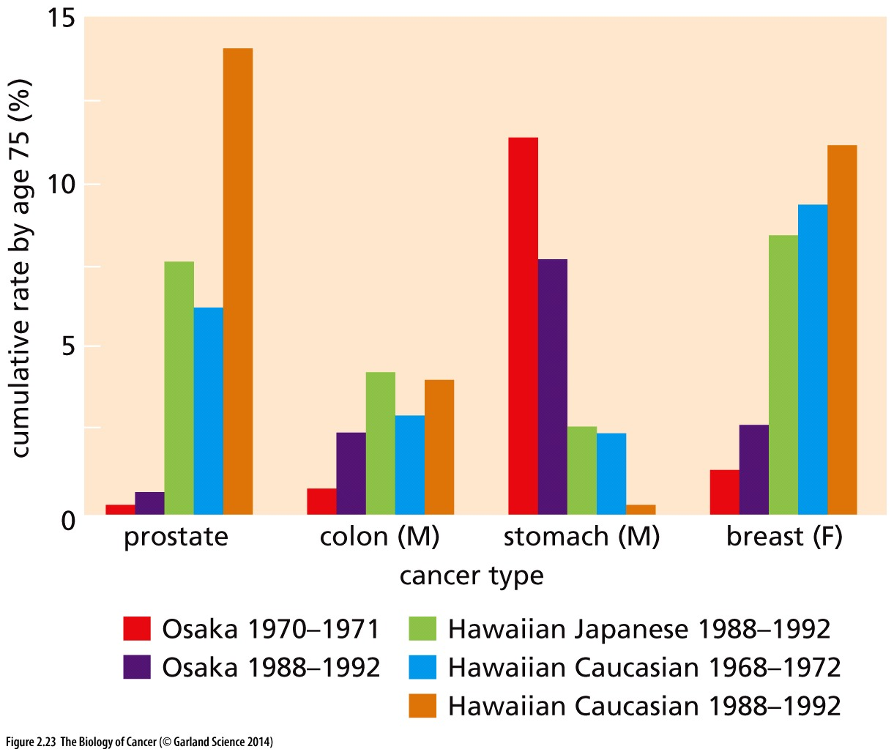
Figure 2.23 Country-to-country comparisons of cancer incidence
Public health records reveal dramatic differences in the incidence of certain cancers in different countries. Here, the relative incidences of a group of cancers in Japan and in the American island of Hawaii are presented. Invariably, after Japanese have immigrated to Hawaii, within a generation their cancer rates
approach those of the population that settled there before them. This indicates that the differing cancer rates are not due to genetic differences between the Japanese and the American populations.
大阪
Life style is important than genetic background sometimes

Slide 61
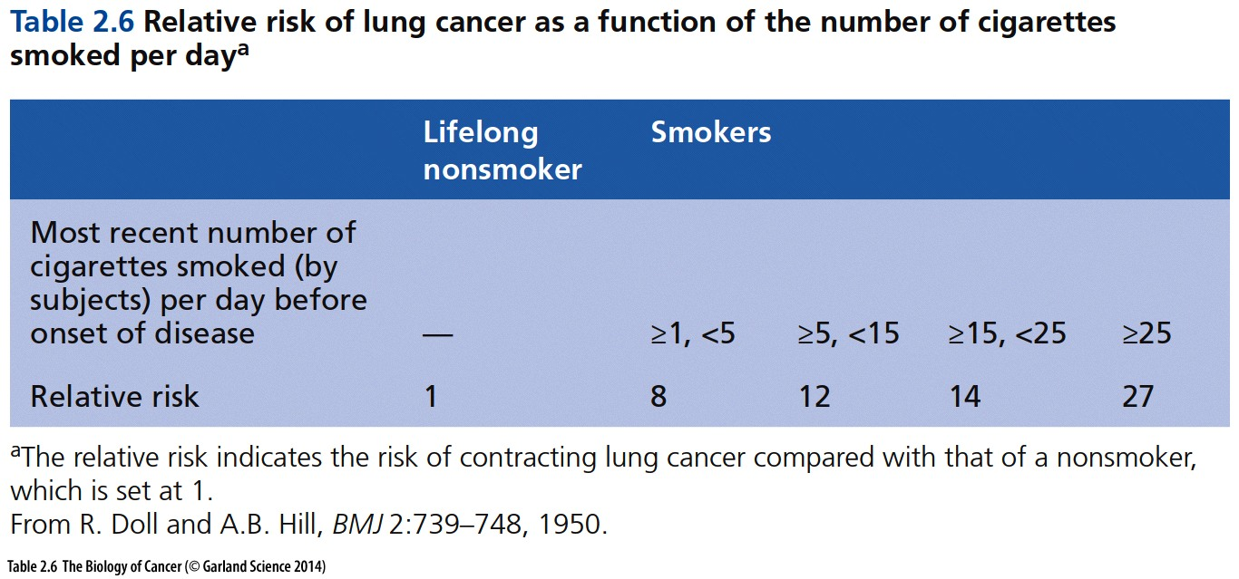
Smoking and cancer

Slide 62
2.9 Specific chemical agents can induce cancer

Slide 63
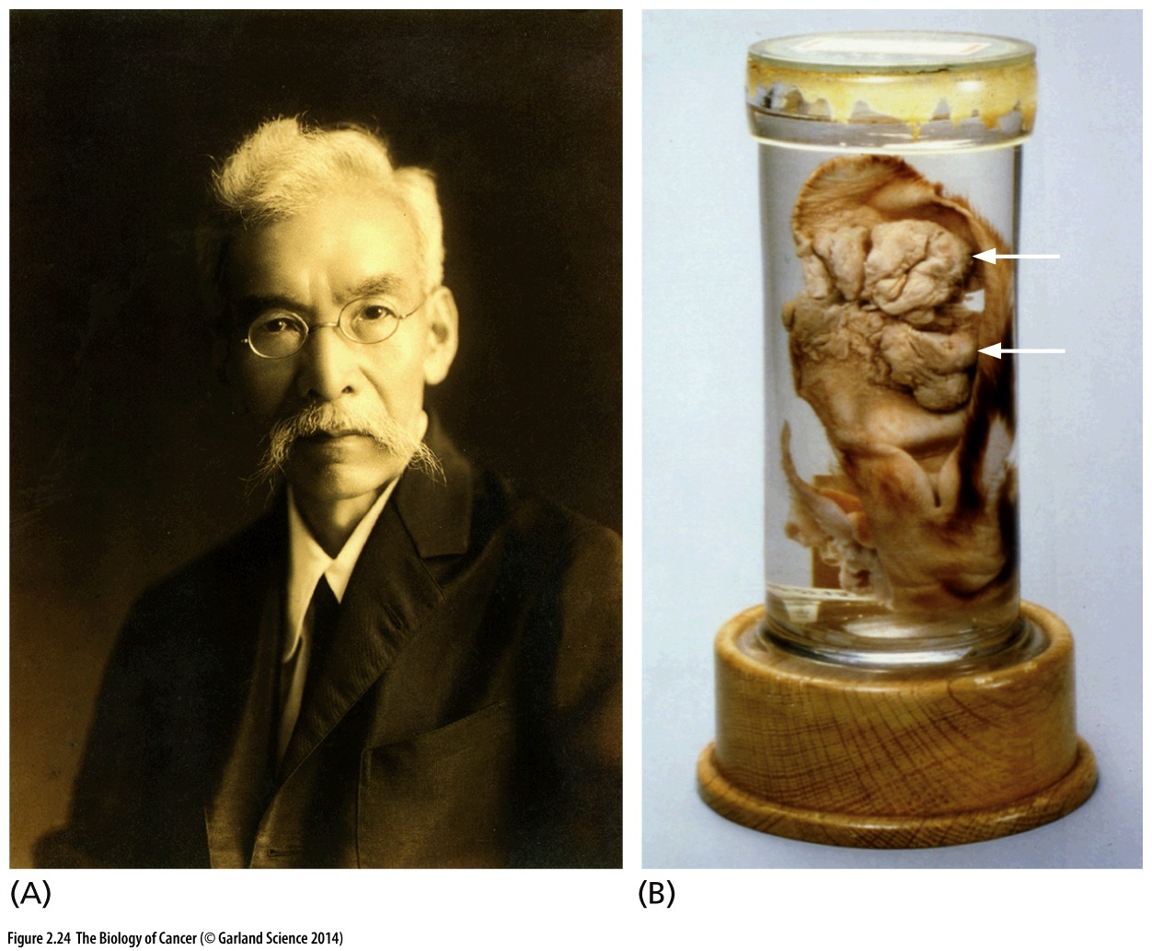
Figure 2.24 The first induction of tumors by chemical carcinogens
(A) In 1915, Katsusaburo Yamagiwa reported the first successful induction of cancer by repeated treatment of rabbit ears with a chemical carcinogen, in this case coal tars. (B) The skin carcinomas (arrows) that he induced on the ears of these rabbits are preserved to this day in the medical museum of the University of Tokyo. This particular carcinoma was harvested and fixed following 660 days of painting with coal tar.

Slide 64
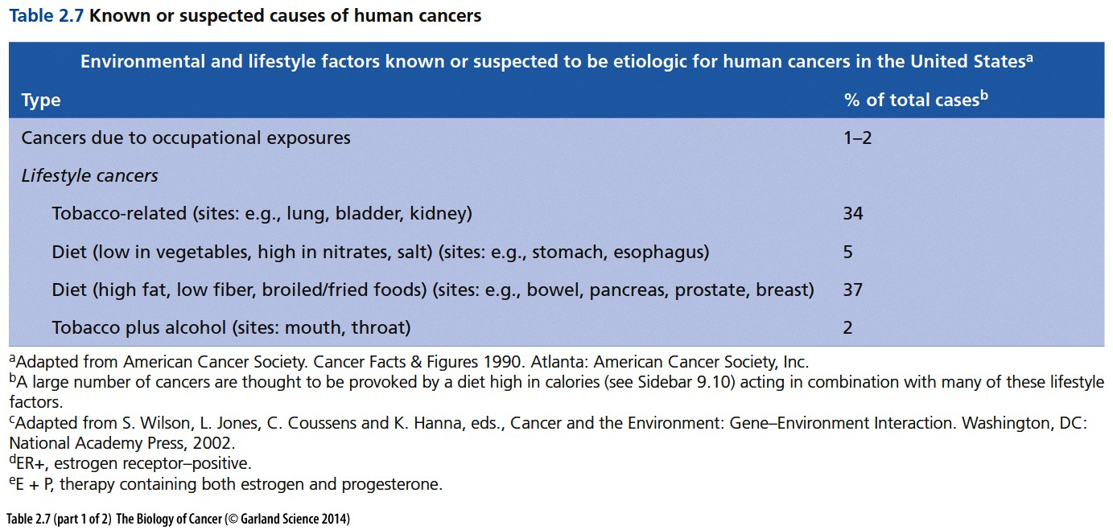

Slide 65
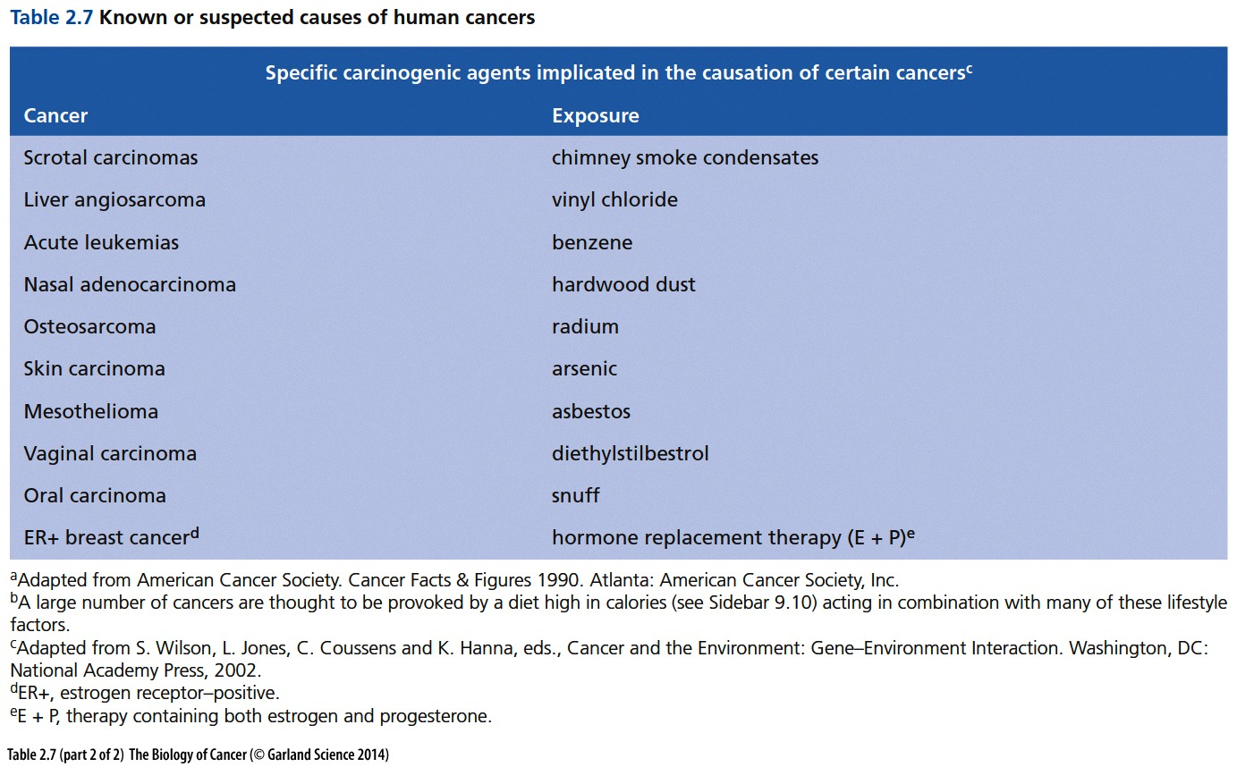
阴囊

Slide 66
2.10 Both physical and chemical carcinogens act as mutagens
In 1927, Hermann Muller discovered that he could induce mutations in the genome of Drosophila melanogaster by exposing these flies to X-rays.

Slide 67
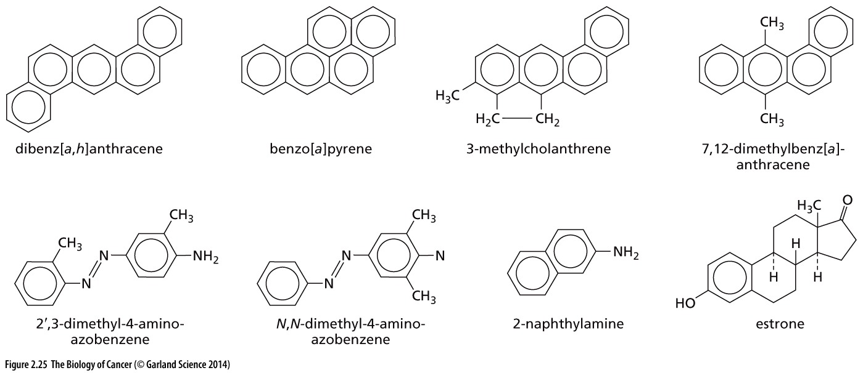
Figure 2.25 Structures of carcinogenic hydrocarbons(烃)
These chemical species arise from the incomplete combustion(燃烧) of organic (for example, carboncontaining) compounds. Each of the chemical structures shown here, which were already determined before 1940, represents a chemical species that was found, following purification, to be potently carcinogenic. The four compounds shown in the top row are all polycyclic aromatic hydrocarbons(多环芳香烃)(PAHs).

Slide 68

Figure 2.26 Structure of the Philadelphia chromosome
Analyses of the banding patterns of stained metaphase chromosomes of chronic myelogenous leukemia (CML) cells first revealed the characteristic chromosome (called the “Philadelphia chromosome”) that is present in the leukemia cells of most CML patients.
Philadelphia chromosome → BCR-ABC → Imatinib → cure of CML

Slide 69

Figure 2.27 The Ames test for gauging(测量) mutagenicity
The Ames test makes it possible to quantitatively assess the mutagenic potency of a test compound. To begin, the liver of a rat (or other species) is homogenized to release its enzymes. The liver homogenate (brown dots) is then mixed with the test compound (orange), which often results in the liver enzymes metabolically converting the test compound to a chemically activated, mutagenic state (red). This mixture is applied to a dish of mutant Salmonella bacteria (small green dots) that require the amino acid histidine in their culture medium in order to grow. Since histidine is left out of the medium, only those bacteria that are mutated to a histidine-independent genotype (and phenotype) will be able to grow, and each of these will yield a large colony (green) that can be counted with the naked eye, indicating how many mutant bacteria (and thus mutant alleles) were generated by the brief exposure to the activated compound.

Slide 70

Figure 2.28 Mutagenic versus carcinogenic potency
On this log–log plot, the relative carcinogenic potencies of a group of chemicals (ordinate) that have been used to treat laboratory animals (rats and mice) are plotted as a function of their mutagenic potencies (abscissa) as gauged by the Ames test.
Aflatoxin 黄曲霉素

Slide 71
Mutagen and carcinogen
It became apparent that virtually all compounds that are mutagenic in human cells are likely to be carcinogenic as well. However, the converse does not seem to hold: chemical compounds that are carcinogenic are not necessarily mutagenic. Thus, by the 1990s, extensive use of the Ames test showed that as many as 40% of the compounds that were known to be carcinogenic in rodents showed no obvious mutagenicity in the Salmonella mutation assay. So, the conclusions drawn from the initial applications of Ames’s test required major revision: some carcinogens act through their ability to mutate DNA, while others promote the appearance of tumors through nongenetic mechanisms. We will encounter these nonmutagenic carcinogens, often called tumor promoters, again in Chapter 11.

Slide 72
课后作业
1. 发生在皮肤的黑色素瘤(melanoma)，为什么不属于carcinoma？
2. 简述Warburg effect的表现形式以及可能机制
3. X-ray 致癌的机理是什么？
4. 简述Mutagen 和carcinogen的区别和联系
5. Ames 实验在判定一个chemical致癌能力时的局限性有哪些？

